Slide 1


Mastering Resources:
Unlocking the Keys to Success
WEBINAR
NVBDC.ORG
888-CERTIFIED

Slide 2


Mastering Resources:
Unlocking the Keys to Success
NVBDC.ORG/NVBDC-SERVICES
WEBINAR

Slide 3




NVBDC.ORG
Paul Mara
DSDC
Be Contract Ready by Diverse Supplier Development Corporation (DSDC): DSDC specializes in helping empower all service-disabled and veteran-owned businesses to succeed in the private sector. Paul F. Mara and Mark Hollingshead will discuss their vetted bench approach designed to assess and prepare SD/VOBs to be “contract ready” for corporations
NVBDC.ORG/NVBDC-SERVICES

Slide 4



Who We Are
Diverse Supplier Development Corporation (DSDC)
Began development in 2015 & formally established in 2017
Became a Corporate & SD/VOB Outreach Consultant to the NVBDC in 2017
Developed our Vetted Bench™ Program in late 2020
Mission: Serving as a Guide to Educate & Empower all “SD/VOB-DBEs” to Succeed in the Private Sector Supplier Diversity Space with the Fortune 5,000 corporations
Our Goal: Bringing SD/VOBs together with Corporations for procurement opportunities by going both Upstream & Downstream!
Diverse Supplier Development Corporation

Slide 5

Who We Are
DeltaPoint Partners
  WE SPECIALIZE IN HELPING BUSINESSES SUCCEED!
  At DeltaPoint Partners we bring a team of experienced executed level professionals that specialize in helping businesses succeed by utilizing large private sector procurement opportunities and matching them with pre-qualified and certified Veteran / Diverse Suppliers.

Slide 6
What We Do
We are a fractional outsourced C-Suite bringing 200+ years of business experience over many businesses large and small.
This experience is key to developing our Vetted Bench™ Program
We are a fractional outsourced fully stocked digital & marketing team with 100+ years of marketing and sales/ management experience
We have all the necessary tools and resources to bring massive awareness to our clients’ broad spectrum of potential customers including corporate America
Diverse Supplier Development Corporation

Slide 7



DSDC-DPP Vetted Bench Program
The Vetted Bench Program allows us to leverage and maximize NVBDC Certification!
To be included on the Vetted Bench SD/VOBs undergo a required basic core assessment and screening process to meet the needs of Corporate Procurement and Supplier Diversity Professionals
The Vetted Bench Program is designed to assess and prepare the business readiness of SD/VOBs to be Contract Ready for Corporations by being:
  Stable
  Profitable
  Scalable
  Sustainable
  Third-party private
  sector certified
  Have a private sector friendly/compelling capability statement
  Are contract ready, willing and able to work with Fortune 5,000 corporations
Notes:
We use the term Ready Willing and Able to highlight the key goal for suppliers who complete the the Vetted Bench Program

Slide 8

Pivot to the Private Sector
Benefits of the Vetted Bench Program
Improved business operations
Receive priority in filling “downstream” procurement opportunities
Vetted SD/VOBs are proactively promoted to corporations
Access to a network of coaches, advisors, industry specific subject matter experts
Opportunities for strategic partnerships and develop new business with other SD/VOBs
Comprehensive support and resources to win and then successfully deliver procurement opportunities

Slide 9
Our “Downstream” Success Stories:
Since 2018, we have proactively solicited more than 1,880 separate “Downstream” product and service procurement opportunities seeking DBE Suppliers from 100+ different corporations, including the likes of:
Diverse Supplier Development Corporation
Abbott
Accenture
AT&T
Best Buy
Boeing
Capital One (more than 80)
Disney (current opportunities)
Dupont
General Dynamics
Hallmark
Medtronic
NFL for the Super Bowls
Target
T-Mobile
UNFI
UnitedHealth Group
So far in 2024, we worked on 642 “Downstream” opportunities!

Slide 10
Our “Upstream” Outreach Statistics
Diverse Supplier Development Corporation
For our clients we develop multiple lead lists of their potential client demographics and then reach out daily to bring awareness to our client’s core competencies and differentiators to create interest and opportunities
For the months of April through July of this year, we reached out to 559 client demographic lists and sent emails to 429,168 contacts on behalf of our clients.
From these outreaches 109,752 opened the emails (a 26.2% open rate) and 31,396 (28.6%) of those that opened the emails, went to the websites of our clients to learn more.
Additionally, we reached out to thousands of corporate supplier diversity and procurement professionals on our client’s behalf.

Slide 11
Thank You for Attending!
Please feel free to contact us for additional information.
Mr. Paul F. Mara
US Army Veteran
Diverse Supplier Development Corp & National Veteran Business Development Council
612-889-5887
pmara@advicoach.com
info@dsdcpro.com
Mr. Mark Hollingshead
DeltaPoint Partners
315-766-8906
mthollingshead@deltapointpartners.com
Diverse Supplier Development Corporation

Slide 12


NVBDC.ORG
Yaryna Hotlib
CEO: NANA FUND
Webinar Highlights and Speakers:
Secure Your Financial Future by Nana Fund: The NANA Fund tailors funding opportunities for veteran-owned businesses, matching SD/VOBs with the right grants, support programs, loans, and other options tailored to their specific needs.
NVBDC.ORG/NVBDC-SERVICES

Slide 13


Introduction to
Nana Fund
Your Ultimate Funding Solution
A product of GetGrant Inc. © 2024. All Rights Reserved

Slide 14
Our Mission
To become the ultimate answer to the question: 'How can I get funded?'
Like Uber for cabs and Airbnb for vacation rentals, Nana Fund is here to help you get money for your company.
Nana Fund | Empowering Your Vision, Securing Your Future | www.nana.fund

Slide 15




Why Nana Fund?
90%+
Startups fail due to lack of funding.
80%
Don’t make it past their second year.
Start with strong cash flow and ensure you have at least a two-year runway.
Nana Fund by the Numbers
$8,575,700+
Total grant funds
$9,995,000+
Total Loan funds
$6,749,500+
Total program funds
Nana Fund | Empowering Your Vision, Securing Your Future | www.nana.fund

Slide 16

How Nana Fund Works
We gather funding options from all over the internet: grants, support programs, tax credits, accelerators, and loans.
Only the best options with reasonable interest rates, avoiding predatory terms.
Nana Fund | Empowering Your Vision, Securing Your Future | www.nana.fund

Slide 17



Getting
Started
The three simple steps to get started:
  Create an account
  Answer a few questions about your venture
  Enjoy a variety of funding options!
Nana Fund | Empowering Your Vision, Securing Your Future | www.nana.fund

Slide 18
Grants: Free Money
Money you don't need to pay back.
Supports industries or social projects.
Typical grants for micro, small businesses, and startups: up to $20K.
Government grants are higher but often less accessible to startups.
Nana Fund | Empowering Your Vision, Securing Your Future | www.nana.fund

Slide 19




Support Programs: Four Categories
Incentive Programs:
Utility bill forgiveness
Loan repayment support.
Learning Opportunities:
Accelerators
Business courses
Access to networks and capital.
Tax Credits:
Financial incentives through tax reductions.
Investor Opportunities:
Accelerators, pitch competitions, angel investors, and fund requests.
Funding amounts range from $20K to $500K.
Nana Fund | Empowering Your Vision, Securing Your Future | www.nana.fund

Slide 20
Loans: Fuel for Your Business
Access to microloans, regular loans, and more.
Ensuring affordability and reasonable terms.
With Nana Fund, you get a detailed analysis of each question in the application process and suggested responses based on your user profile, streamlining the application process and enhancing your chances of securing funding.
Nana Fund | Empowering Your Vision, Securing Your Future | www.nana.fund

Slide 21
Stay Informed with Nana Fund
New opportunities added weekly.
Notifications about new funding options as soon as they become available.
Nana Fund | Empowering Your Vision, Securing Your Future | www.nana.fund

Slide 22
Join us today and secure the financial future of your business
Discover a new world of funding possibilities with Nana Fund
Get Started
Still have questions?
Contact US
Nana Fund | Empowering Your Vision, Securing Your Future | www.nana.fund

Slide 23

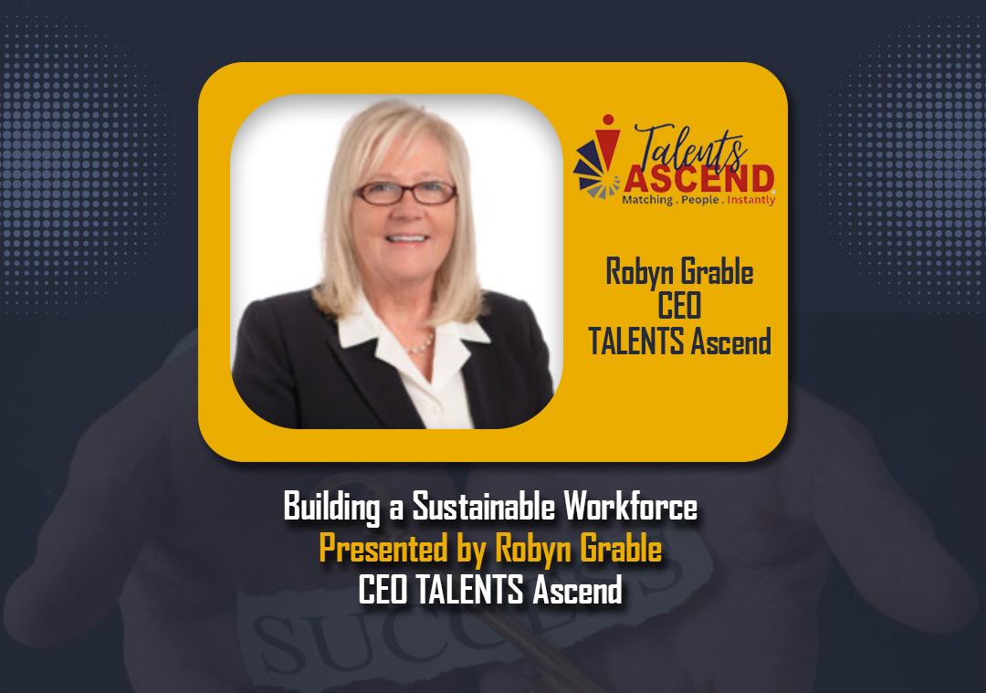
NVBDC.ORG
Robyn Grable
CEO: Talents ASCEND
Building a Sustainable Workforce by Talents ASCEND: Hiring the right team is incredibly important. That’s why Talents ASCEND focuses on skills-based talent sourcing to match employers with qualified candidates. Hear from Talents ASCEND’s founder and CEO, Robyn Grable, on building a sustainable workforce.
NVBDC.ORG/NVBDC-SERVICES

Slide 24

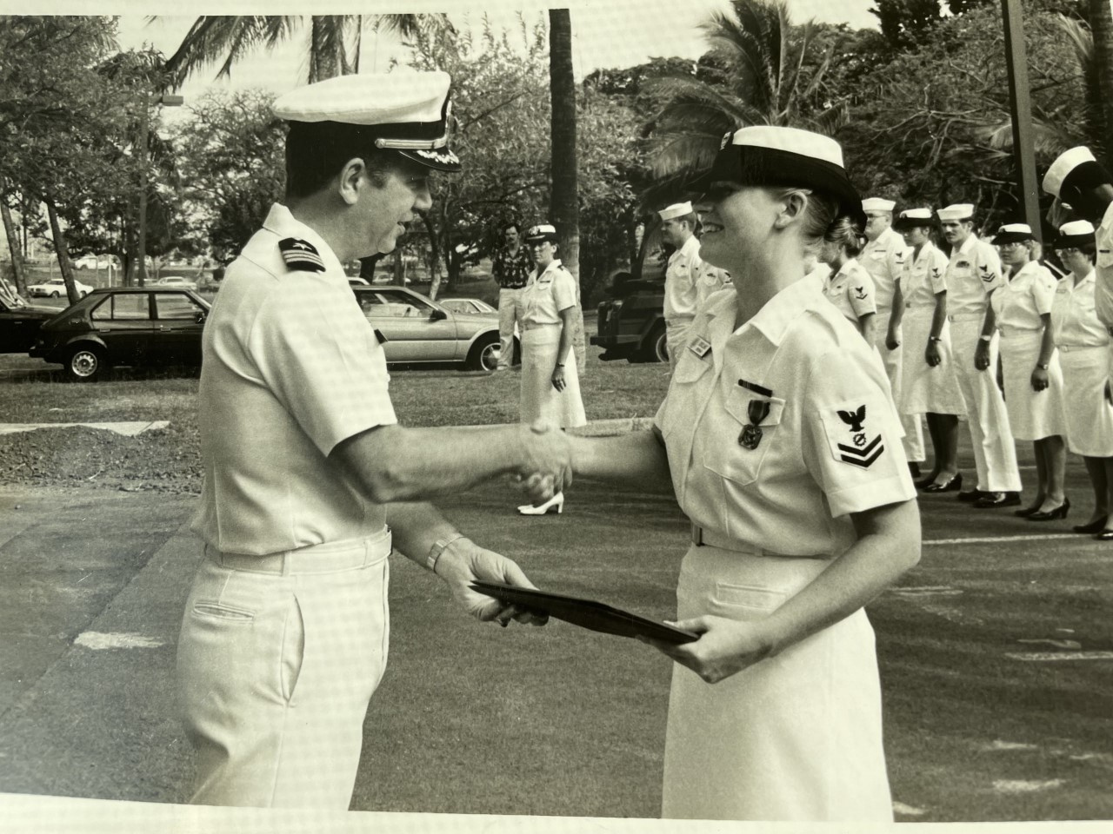

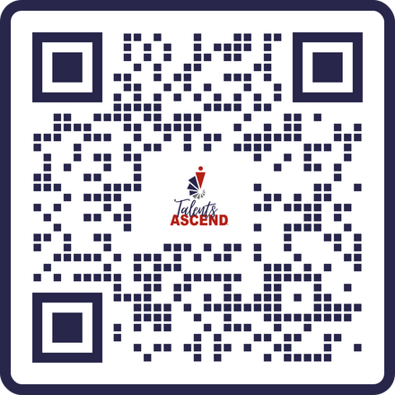

Slide 25







SKILLS-BASED HIRING
A STRATEGIC APPROACH
Accurate Fit for Roles
Focus on Potential and Growth
Build a Sustainable Workforce
Ability to match candidates with roles based on their specific skills and competencies.
Focus on potential fosters a culture of development and engagement, reducing turnover.
Build a diverse and adaptable workforce capable of navigating industry changes and challenges.

Slide 26







Reduce Turnover Costs
Improve Retention
Savings of 30% in turnover costs /$10,000 per hire.
Retention two times better.
Increase Productivity
Foster Innovation
Five times more productive.
Teams are 52% more innovative.
THE FINANCIAL UPSIDE TO SKILLS-BASED HIRING
Lower Recruitment Costs
Achieve Financial Stability
Reduces time-to-hire by 30+ days and hiring costs by 78%. Cumulative savings result in significant financial stability.
Skills-based hiring not only reduces turnover costs but also boosts productivity, enhances employee retention, and fosters a culture of innovation.

Slide 27




COMMUNITY
IMPACT
Skills-based hiring addresses societal challenges by promoting inclusivity. By focusing on what individuals can do rather than their past circumstances, it creates opportunities for a more equitable and supportive society.
Increased Opportunities
Improved Self-Sufficiency
Enhanced Mental Health
Breaking the Cycle
Offering pathways to stable employment, supporting economic independence.
Improving mental health outcomes, and breaking cycles of poverty and recidivism.

Slide 28
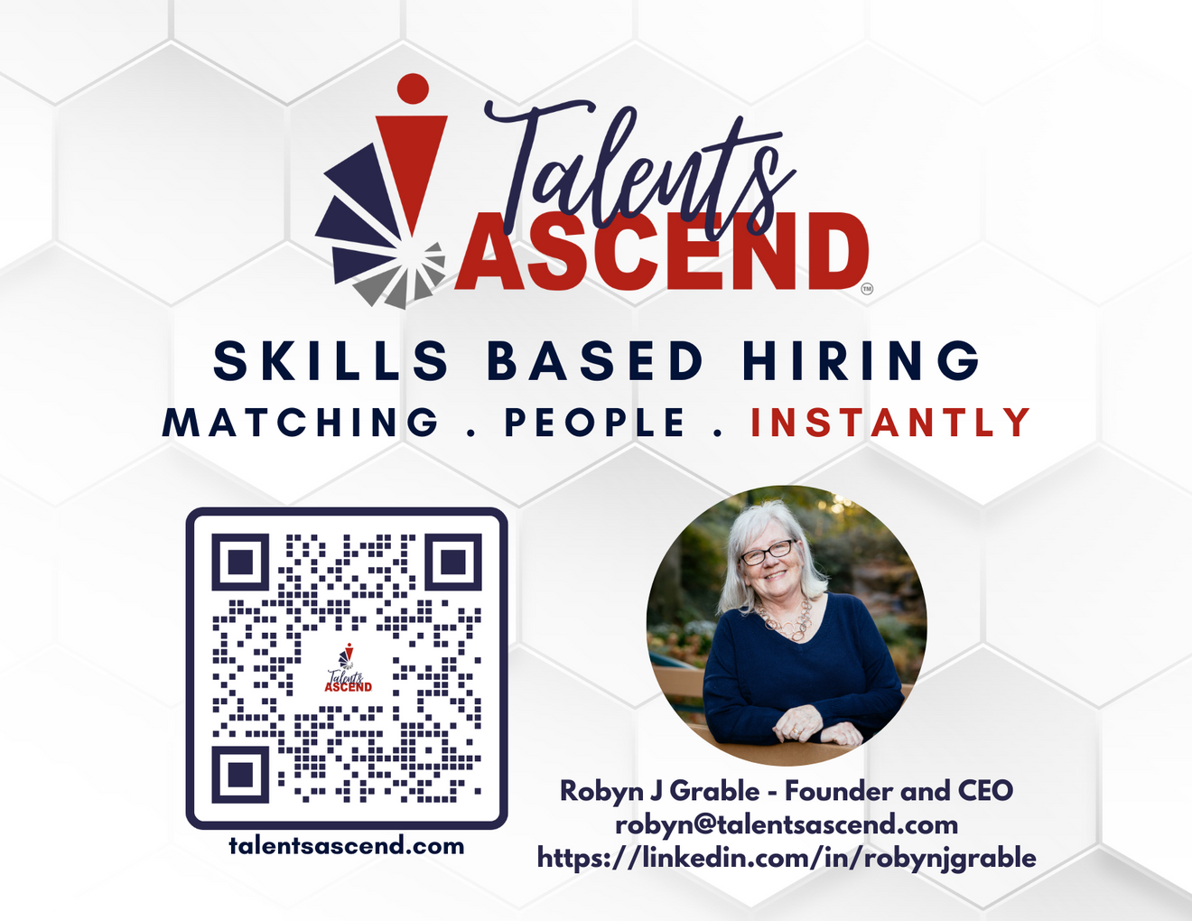

Slide 29

Mastering Resources – Unlocking the
Keys to Success
Q AND A
NVBDC.ORG
888-CERTIFIED

Slide 30
Thank you for attending our New Webinar Series:
Mastering Resources – Unlocking the
Keys to Success
NVBDC.ORG
888-CERTIFIED

Slide 31
Contact Us Below
John Taylor: jtaylor@nvbdc.org
Kathy Poynton: kpoynton@nvbdc.org
Paul Mara: pmara@advicoach.com
Yaryna Hotlib: y.hotlib@nana.fund
Robyn Grable: robyn@talentsascend.com
NVBDC.ORG
888-CERTIFIED

