Slide 1

2024 NVBDC JumpStart Webinar
How to Do Business with Delta Air Lines

Slide 2

Veteran-to-Veteran Business Opportunities
Connect with your fellow SD/VOBs!
Enter the following information in the chat:
Name
Business
Email
Location
Services/Products Offered
Services/Products Needed
Don’t forget to register your business with VOCS, NVBDC’s Veteran-to-Veteran connection program!

Slide 3
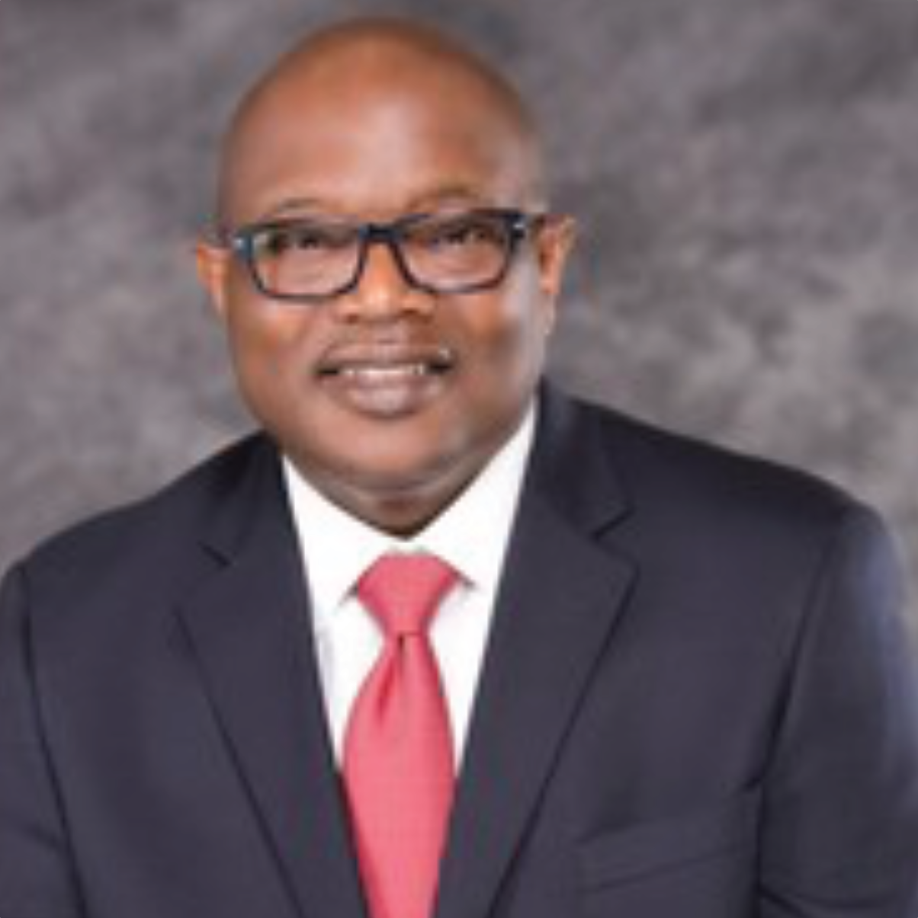
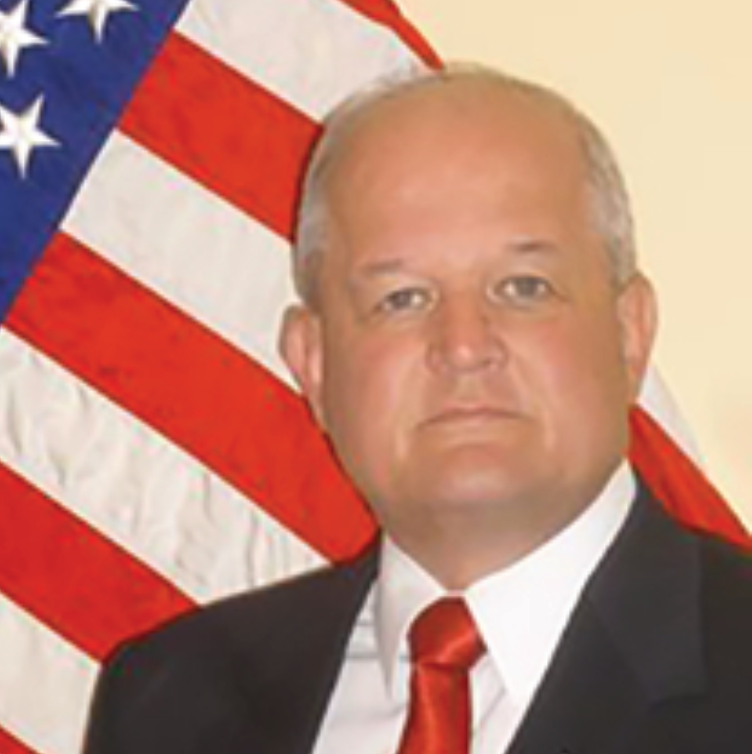
Opening Remarks
John E. Taylor (“JT”)
NVBDC Board Member
Chair, Services Committee
Richard Miller
Brigadier General (Ret)
President, NVBDC

Slide 4
Agenda
Opening Remarks
Tips for Today
Meet Our Speaker
Presentation
Q & A
Wrap-up

Slide 5
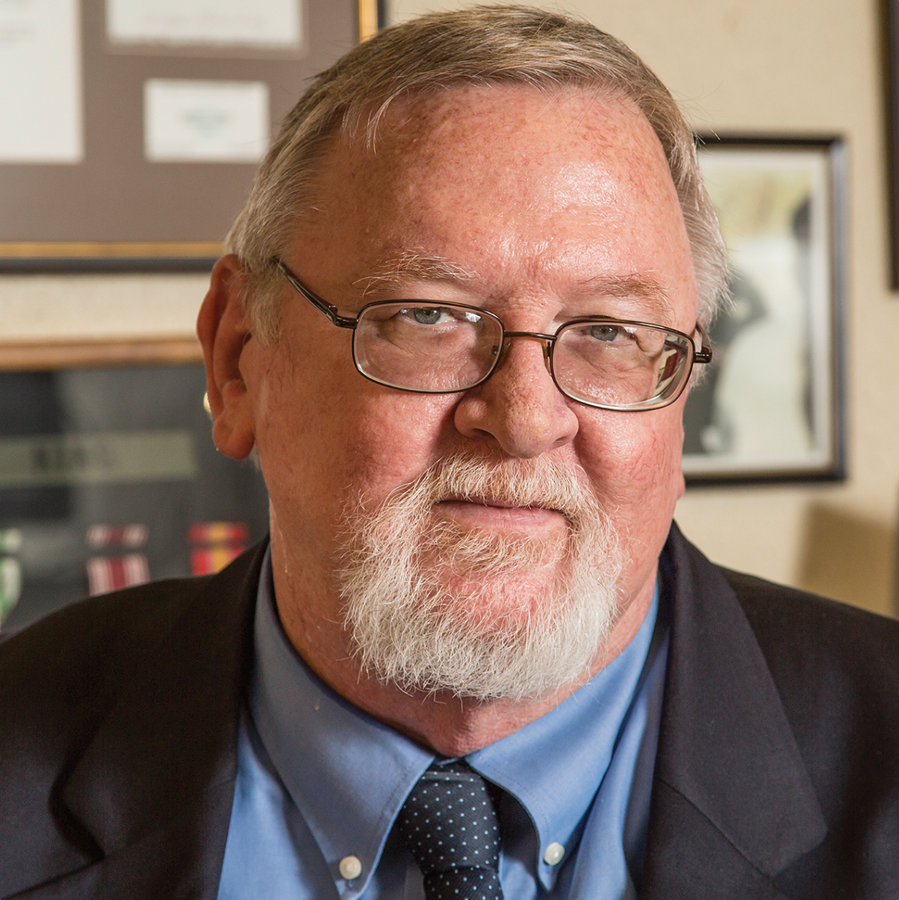
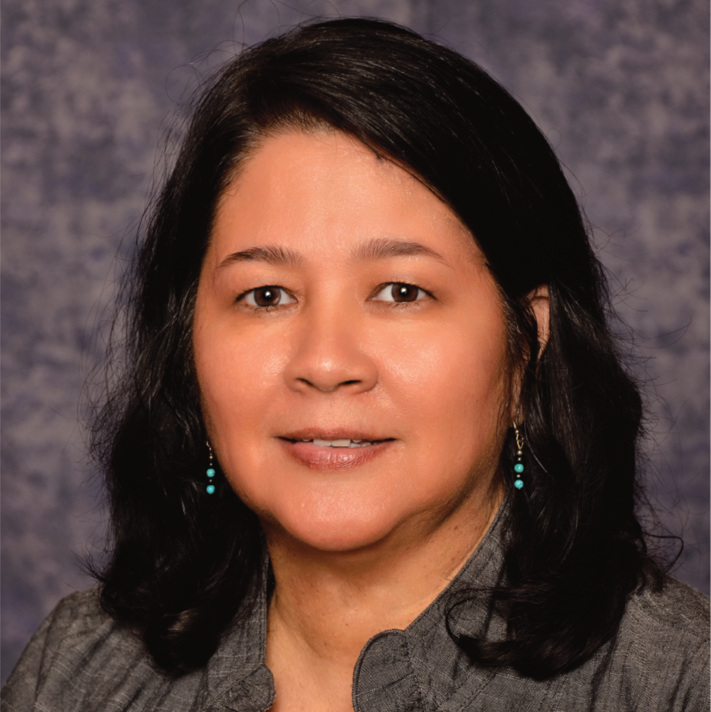
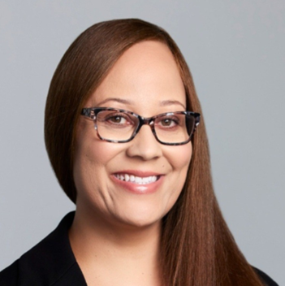
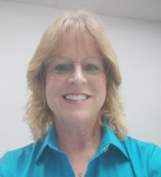
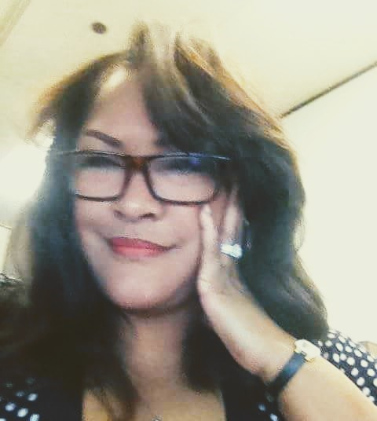
Meet the Services Committee
Expanding Access, Opportunity and Training
Keith King
Founder and CEO
Brigadier General (Ret) Richard Miller
President
John E. Taylor (“JT”)
Services Committee Chairman and Board of Directors
Annette Stevenson, US Army Veteran, CPSD, C.P.M.
Board of Directors
Tammi Hart
Advisory Board and Certification Committee
Joann “Jo” M. Cobb
Certification Analyst, Certification Committee
Toni Moses
Relationship Manager, Certification Committee

Slide 6
Tips for Today

Slide 7

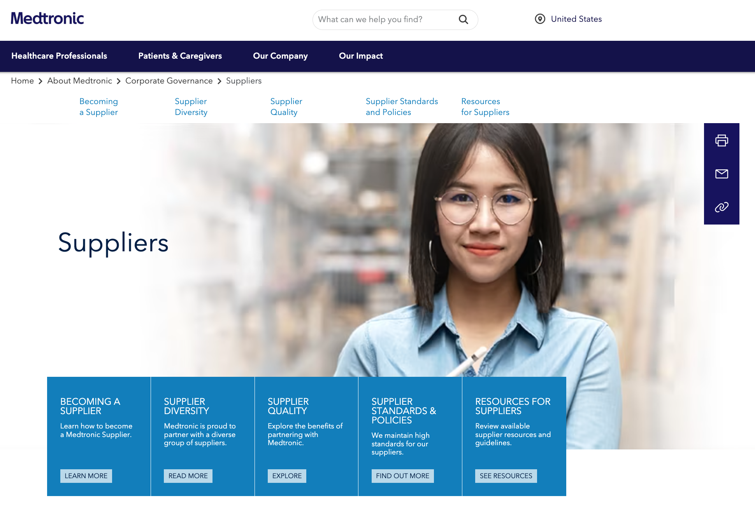

Do Your Homework!
Understand the corporation’s culture and supplier expectations.
Resources to reference:
Business Codes of Conduct
Supplier Standards Documents
Learn about the corporation’s goals and focus.
Resources to reference:
Annual Reports
Environmental, Social, Governance (ESG) Reports
Leverage supplier diversity professionals to help identify opportunities, pain points and unmet needs in their organization.

Slide 8
Corporate Members
180+

Slide 9
Meet Our Speakers

Slide 10
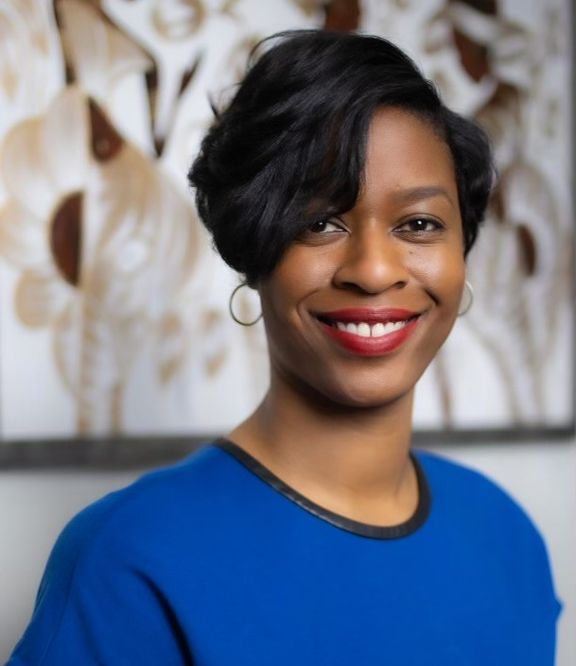
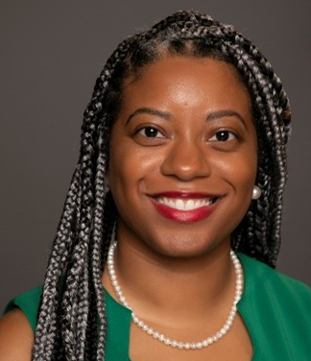
JumpStart Speakers
Makeda Matthews
Sr. Manager of Supplier Diversity
On the surface, Makeda Matthews focuses on supporting Delta in finding, qualifying and integrating diverse suppliers within the supply chain. However, Makeda is working on changing the narrative of supplier diversity from a “good thing to do” to a crucial business strategy to sustain the enterprise.
Andrea Thomas
Supplier Diversity Manager
Andrea Thomas focuses on providing access and opportunities to diverse businesses within Delta Air Lines global operations. She creates inclusive programs and awareness campaigns for small, diverse owned businesses to ensure Delta’s supply chain is reflective of the communities we serve.

Slide 11


Slide 12
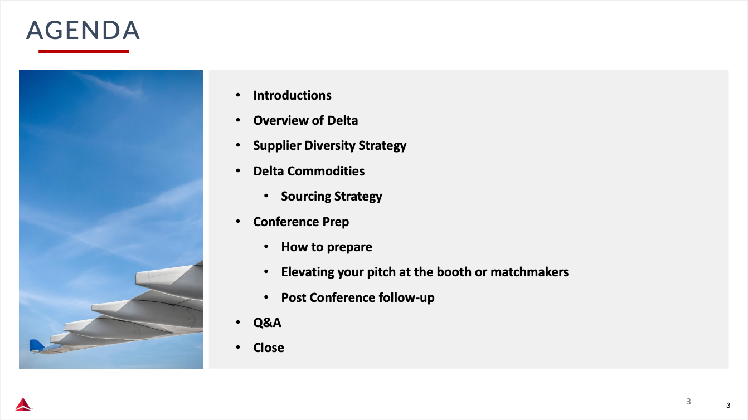

Slide 13
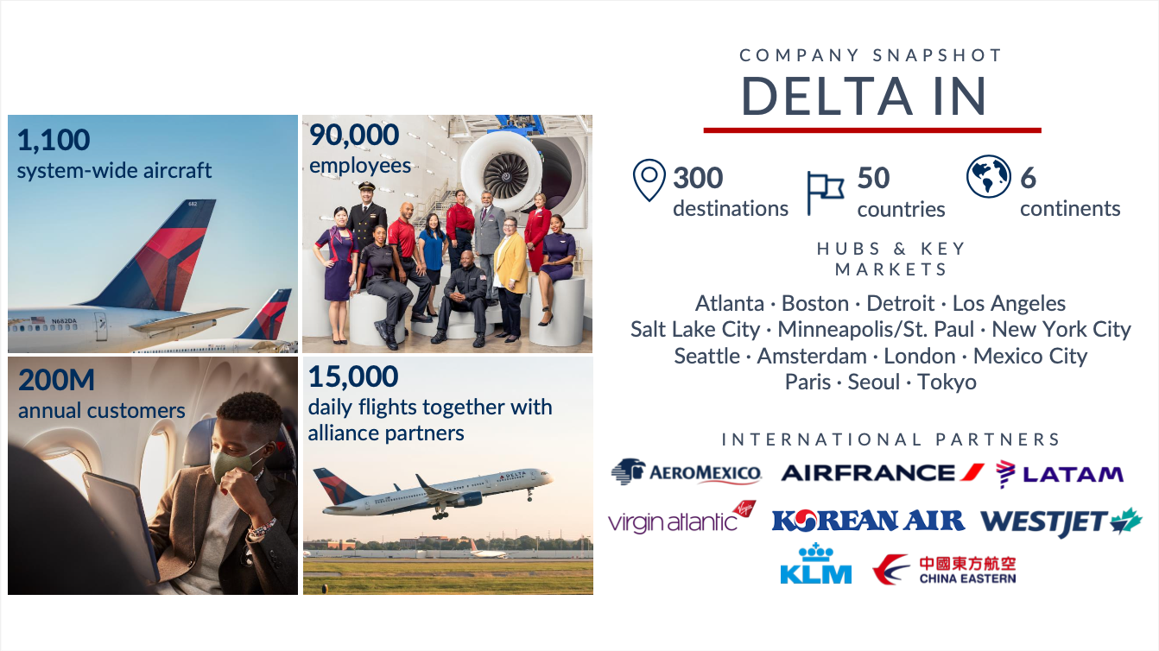

Slide 14
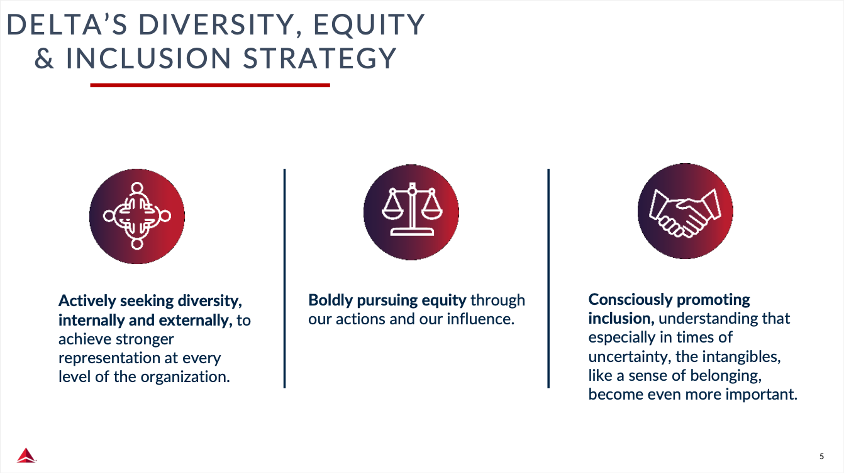

Slide 15


Slide 16
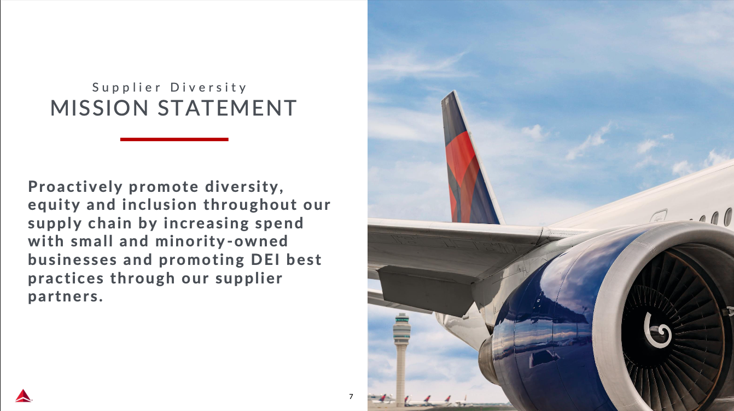

Slide 17
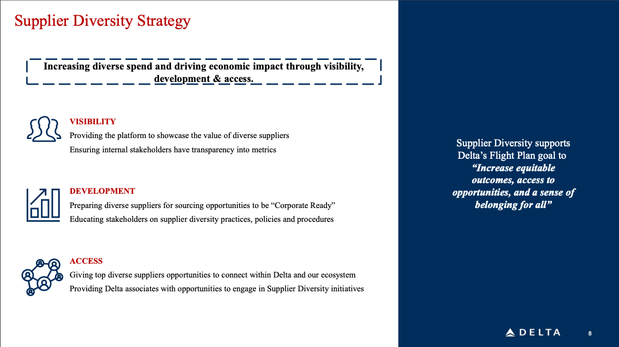

Slide 18
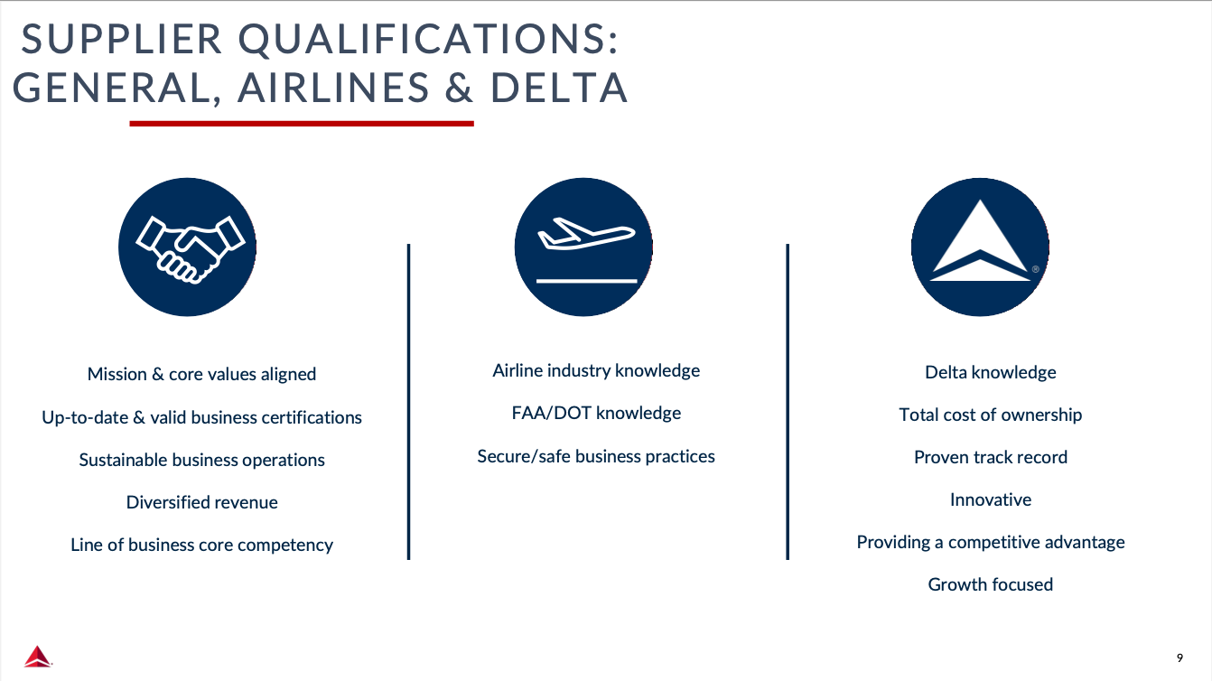

Slide 19
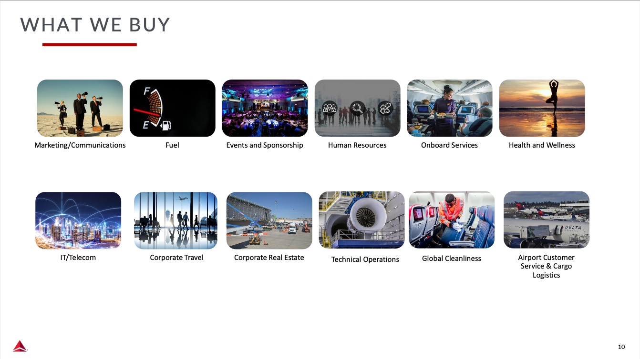

Slide 20


Slide 21
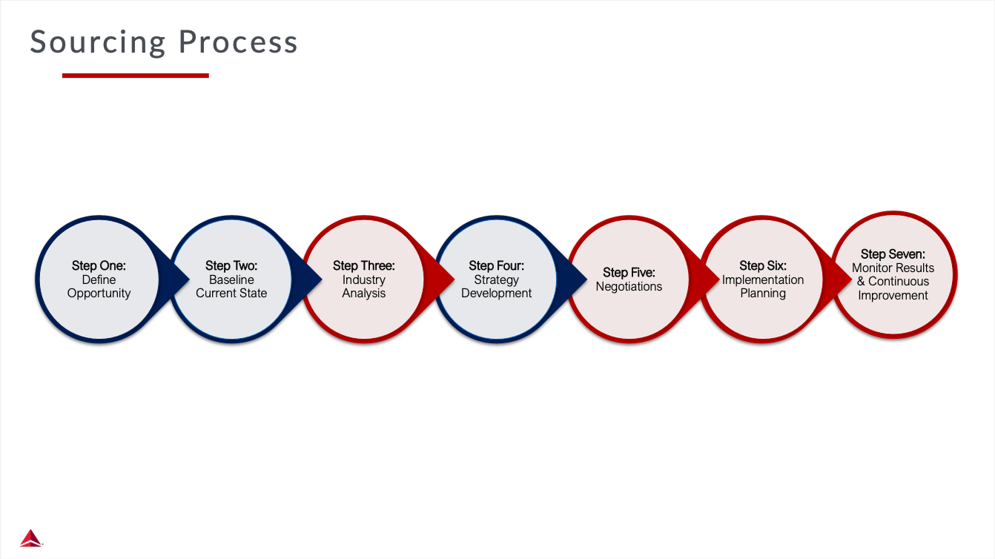

Slide 22


Slide 23
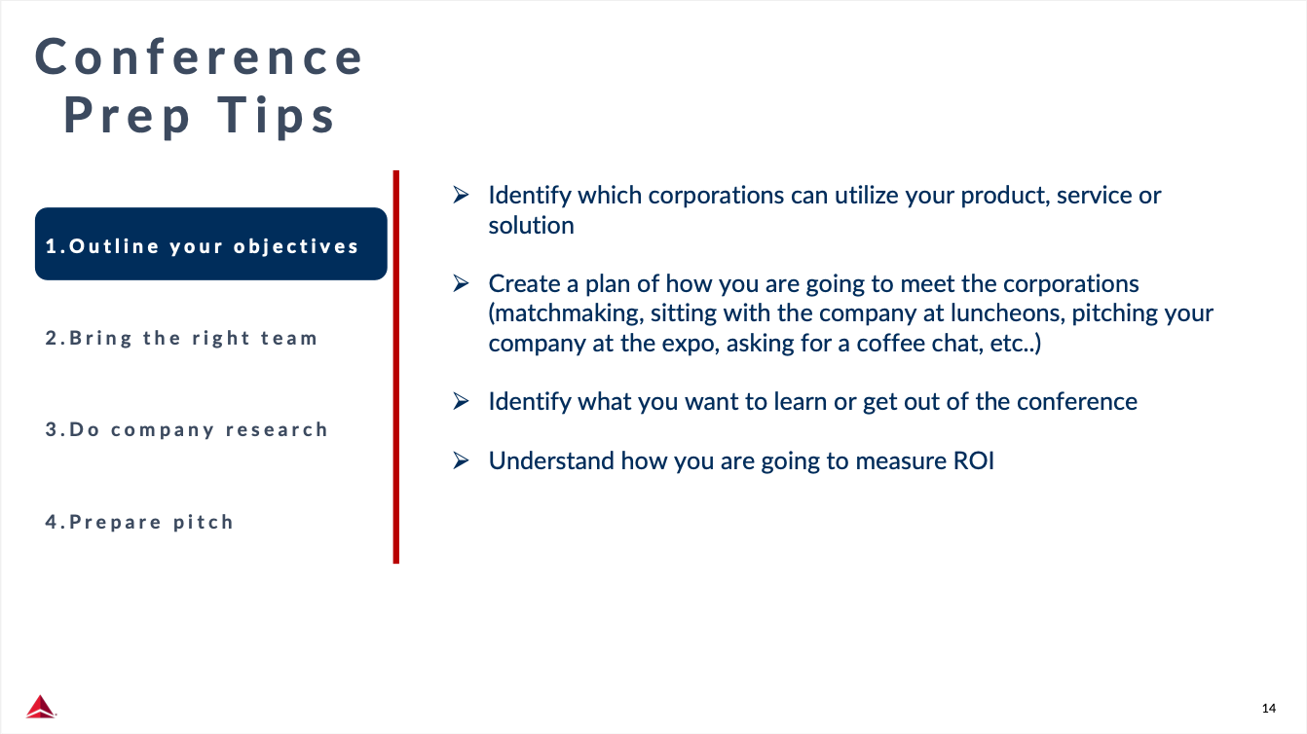

Slide 24
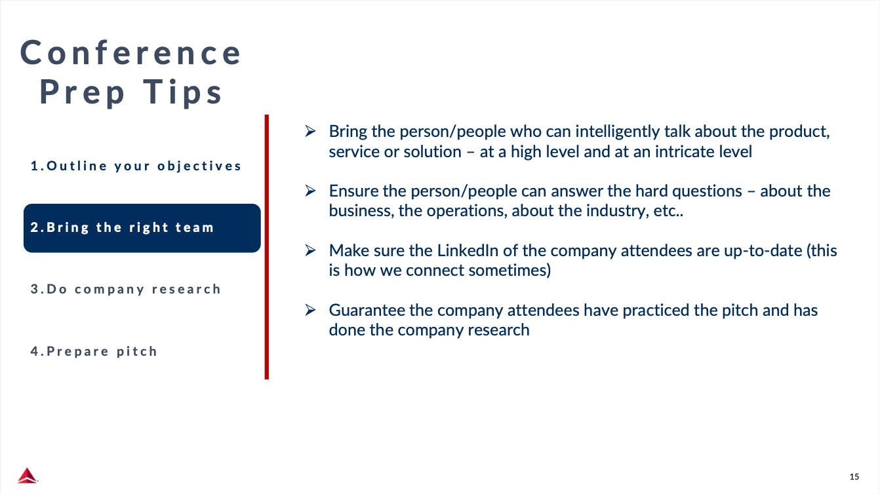

Slide 25
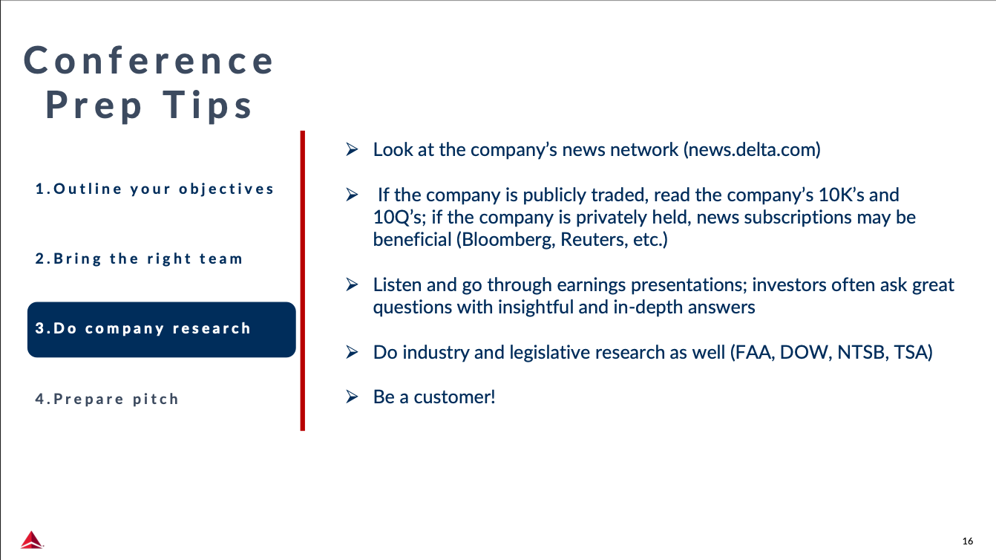

Slide 26
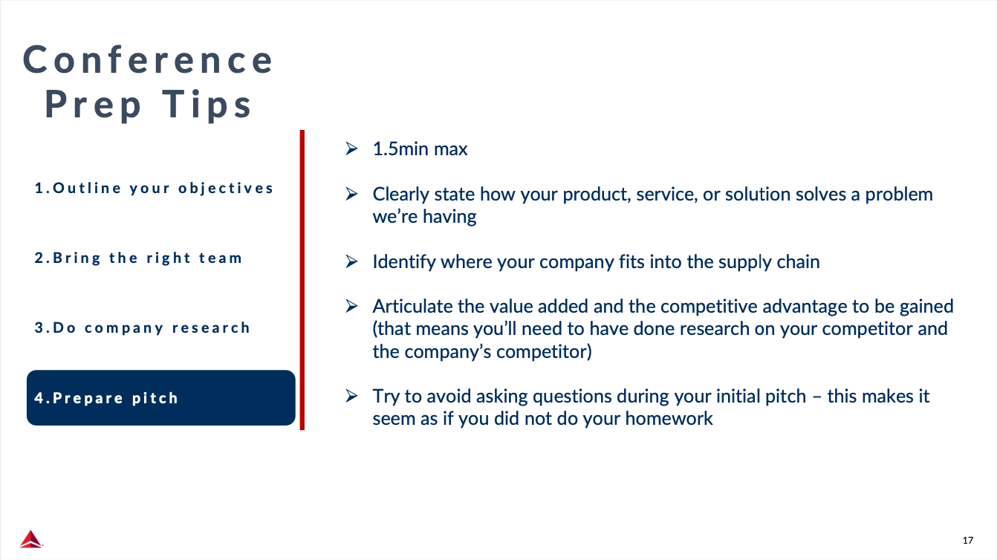

Slide 27
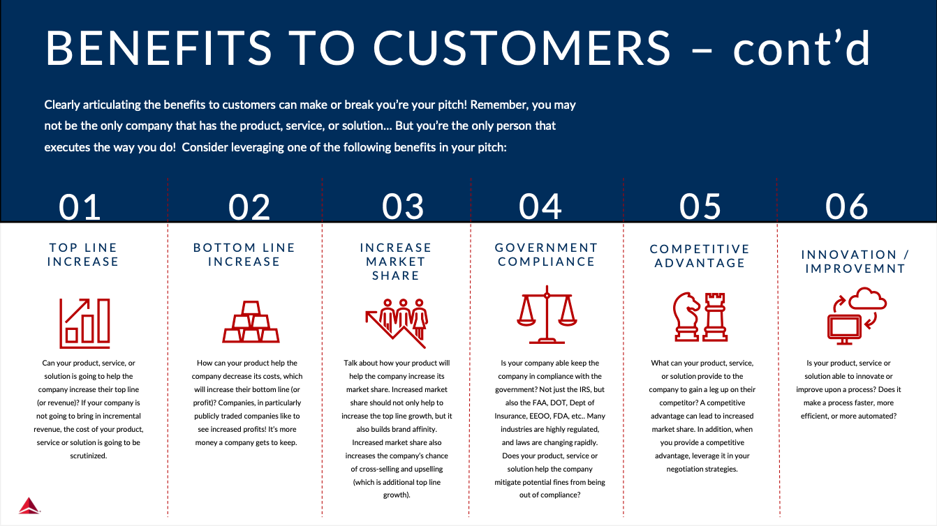

Slide 28
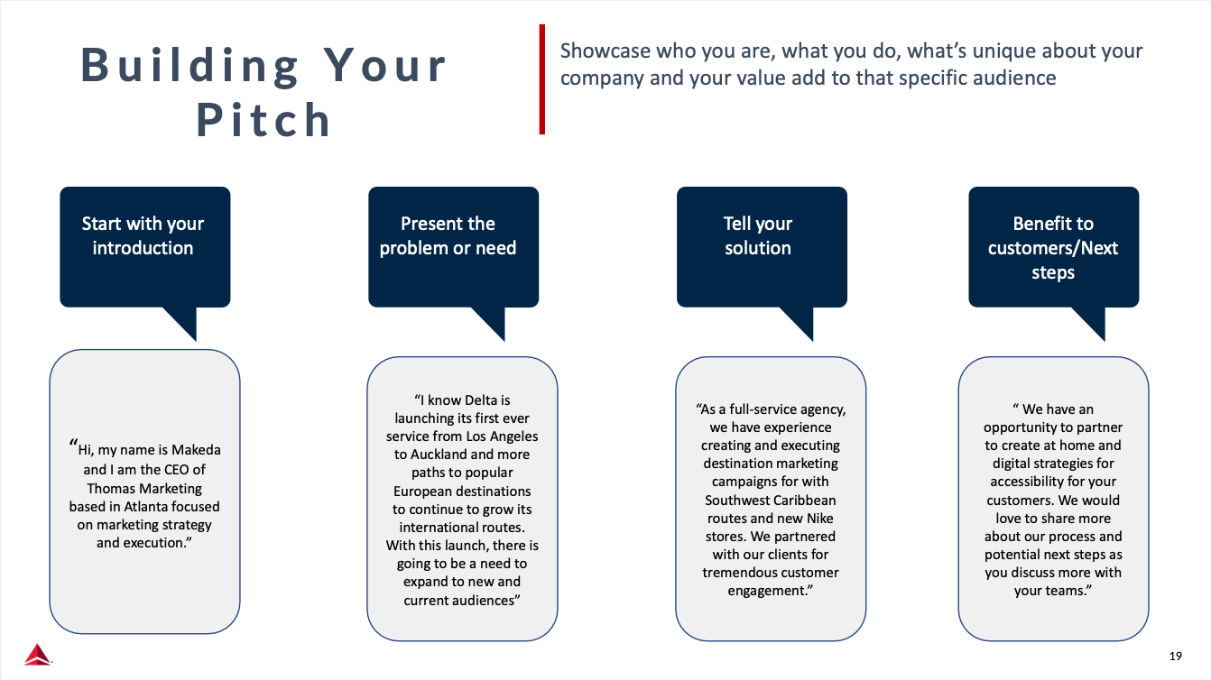

Slide 29


Slide 30
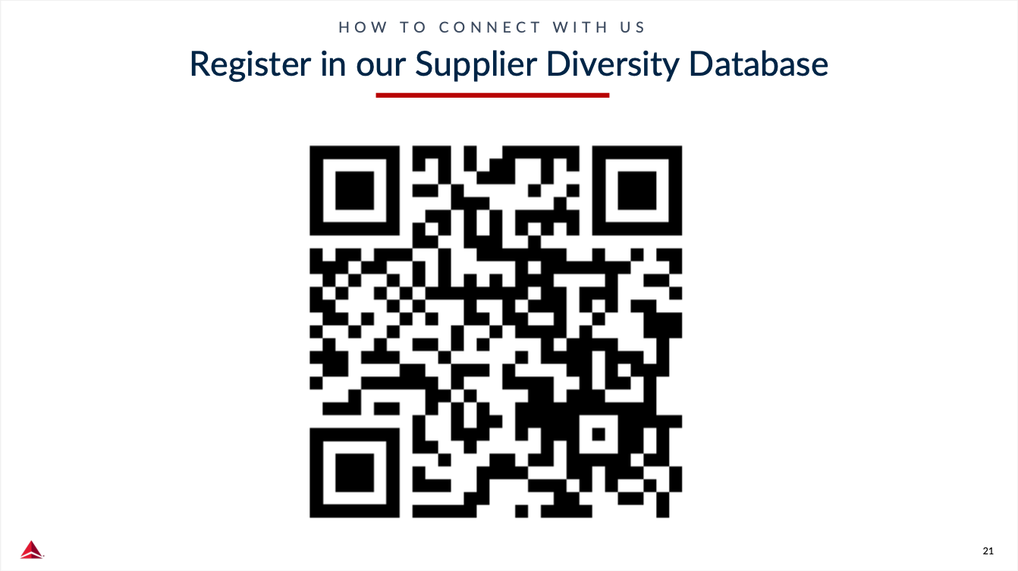

Slide 31
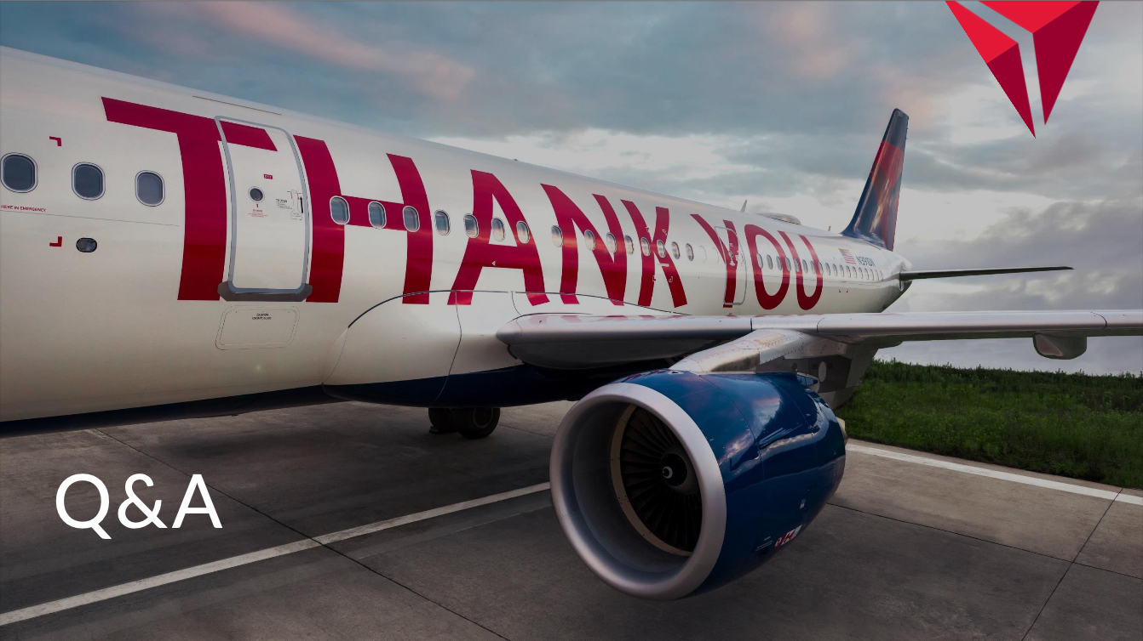

Slide 32
Veteran to Veteran Business Opportunities
Connect With Your Fellow SD/VOBs!
Enter the following information in the chat:
Name
Business
Email
Location
Services/Products Offered
Services/Products Needed
Don’t Forget to Register Your Business With VOCS, NVBDC’s Veteran to Veteran Connection Program!

Slide 33
NVBDC Contacts
Services Committee:
John "JT" Taylor, jtaylor@nvbdc.org
Certification Team:
Jeff King, jking@nvbdc.org
Toni Moses, tmoses@nvbdc.org
Jo Cobb, jcobb@nvbdc.org
MVO Task Force:
Kathy Poynton, kpoynton@nvbdc.org
JROTC Program:
Sid Taylor, staylor@nvbdc.org
Press Releases:
Hannah Waldrep, hwaldrep@nvbdc.org

Slide 34
Thank You for Joining Us Today
Upcoming Webinars
  NVBDC Services JumpStart Webinars
    July 25 – Pfizer
      11:00 a.m. – 12:30 p.m. EDT
    August 22 – UScellular
      11:00 a.m. – 12:30 p.m. EDT
Save the Date!
  “Doing Business with the Federal Reserve & Private Industry”
    August 8, 2024
    Location: Federal Reserve Bank of Detroit
  National Veteran Matchmaking Conference
    October 29-30, 2024
    Location: Detroit, MI
Notes:
29-30th of October, Renaissance Marriot Nationals

Slide 35











NVBDC Corporate Members

Slide 36











NVBDC Corporate Members

Slide 37








NVBDC Corporate Members

Slide 38









NVBDC Corporate Members

Slide 39











NVBDC Corporate Members

Slide 40


THANK YOU!
Call: 888-CERTIFIED
Visit: NVBDC.ORG
Follow Us:

