Slide 1

2024 NVBDC JumpStart Webinar
How to Do Business with Flagstar Bank

Slide 2

Veteran to Veteran Business Opportunities
Connect With Your Fellow SD/VOBs!
Enter the following information in the chat:
Name
Business
Email
Location
Services/Products Offered
Services/Products Needed
Don’t Forget to Register Your Business With VOCS, NVBDC’s Veteran to Veteran Connection Program!

Slide 3
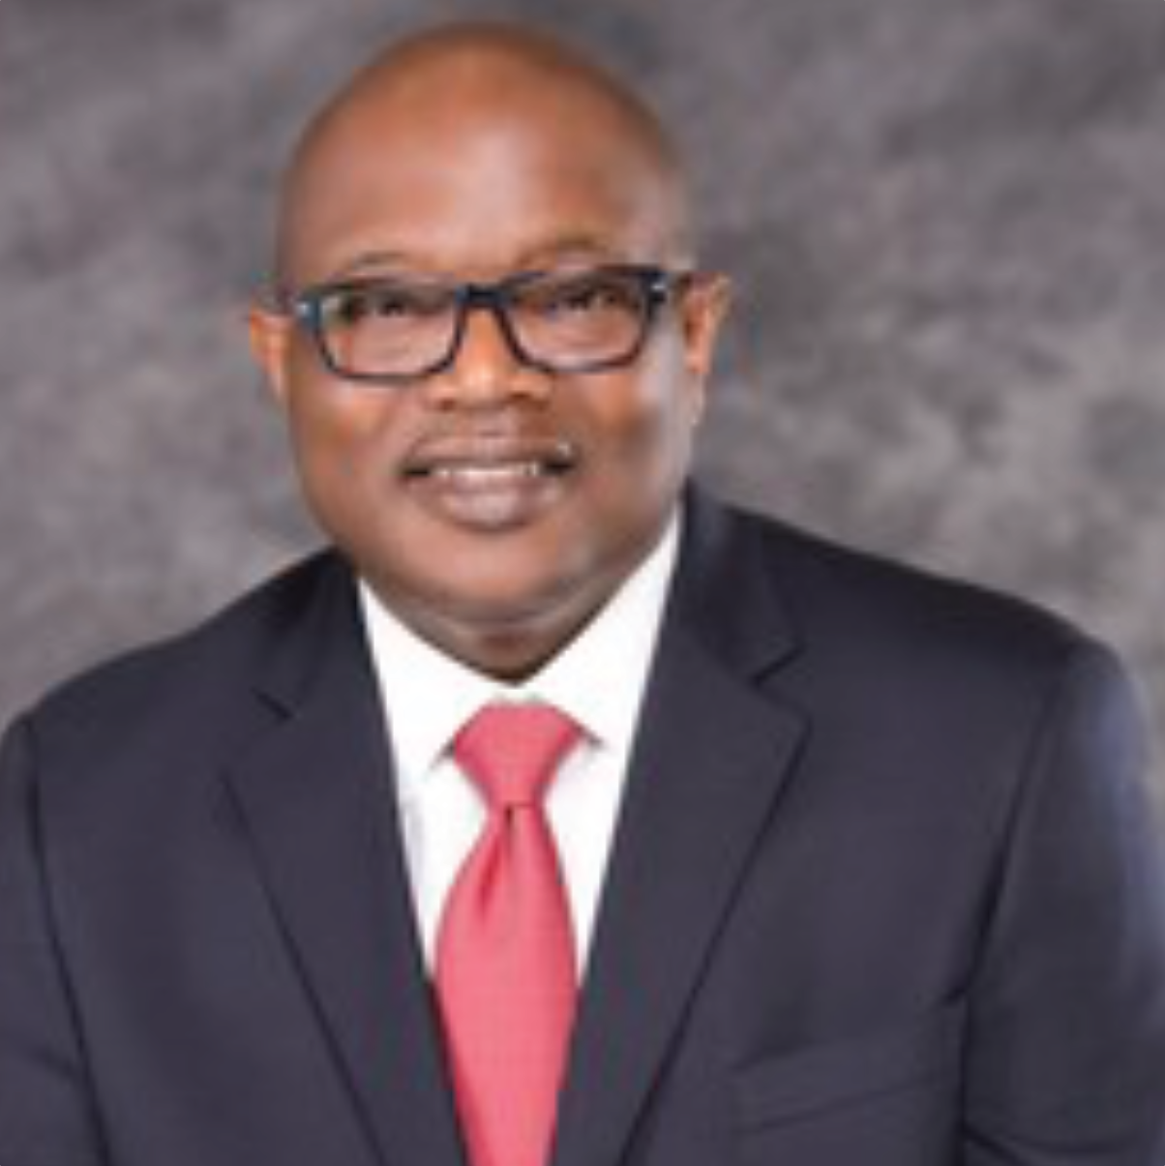
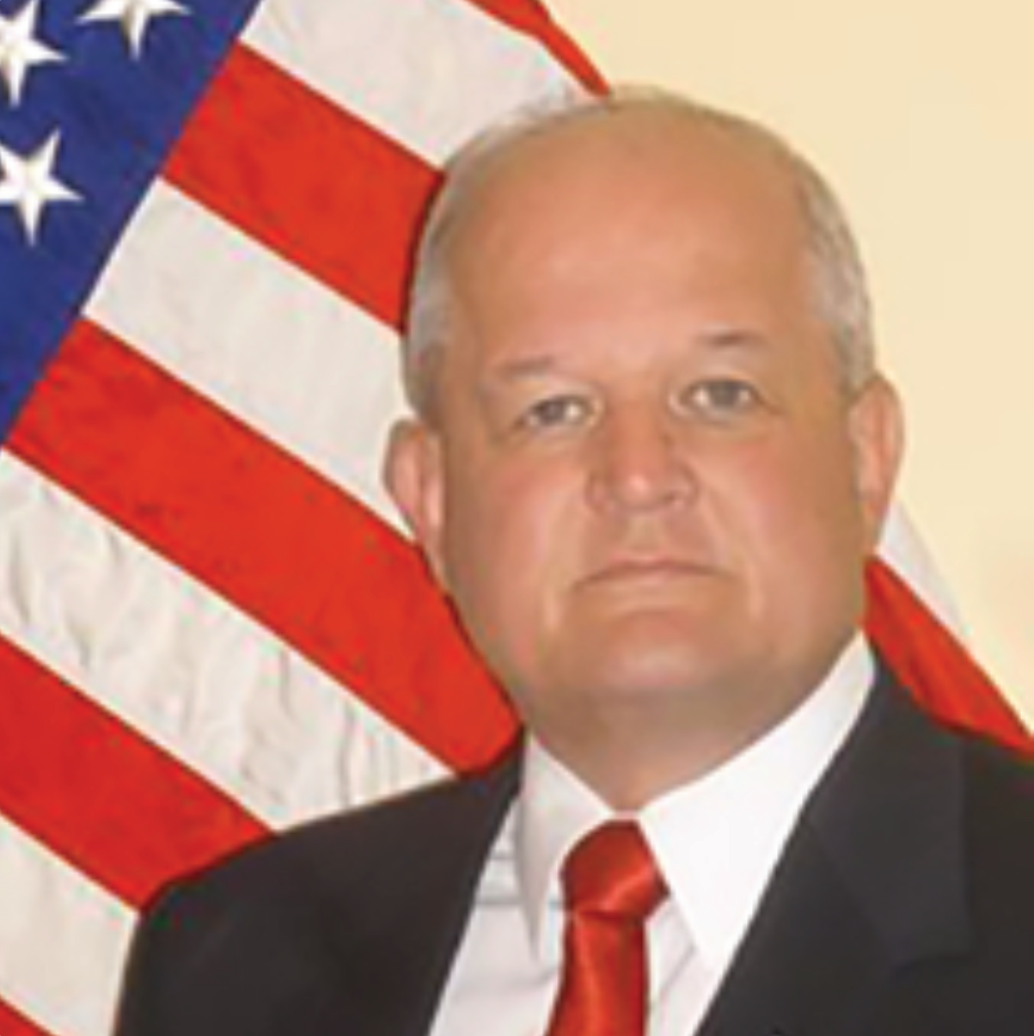
Opening Remarks
John E. Taylor (“JT”)
NVBDC Board Member
Chair, Services Committee
Richard Miller
Brigadier General (Ret)
President, NVBDC

Slide 4
Agenda
Opening Remarks
Tips for Today
Meet Our Speaker
Presentation
Q & A
Wrap-up

Slide 5
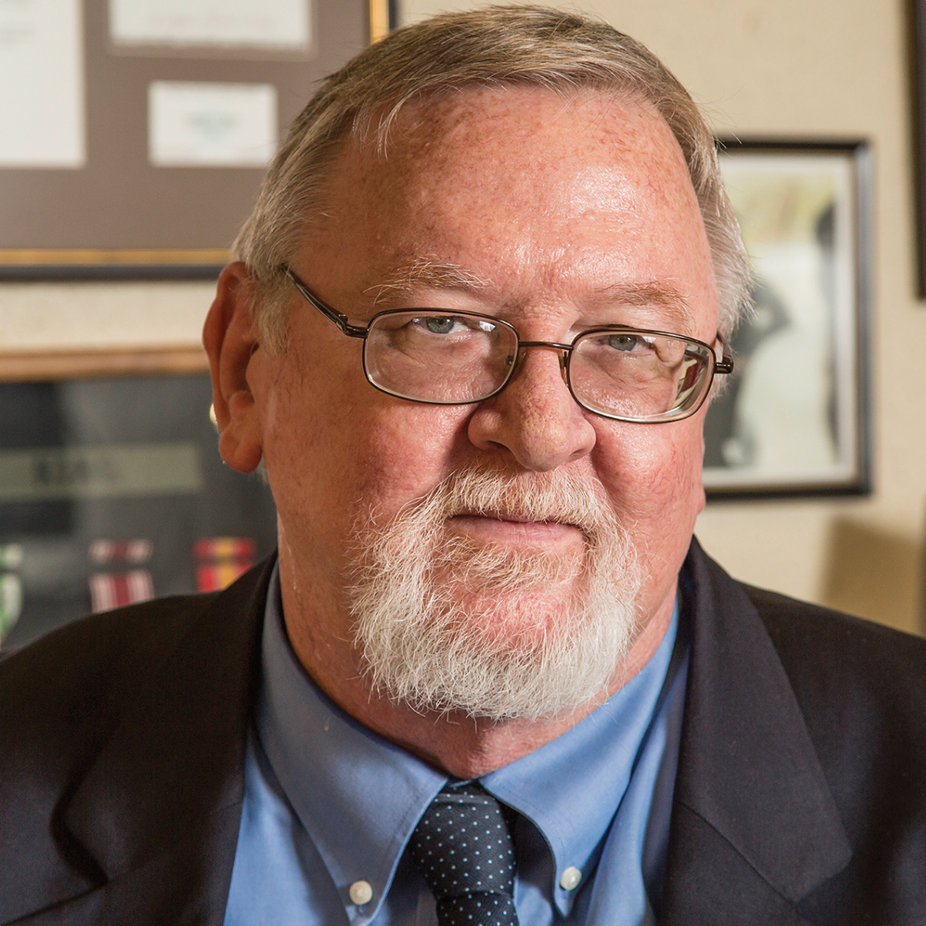
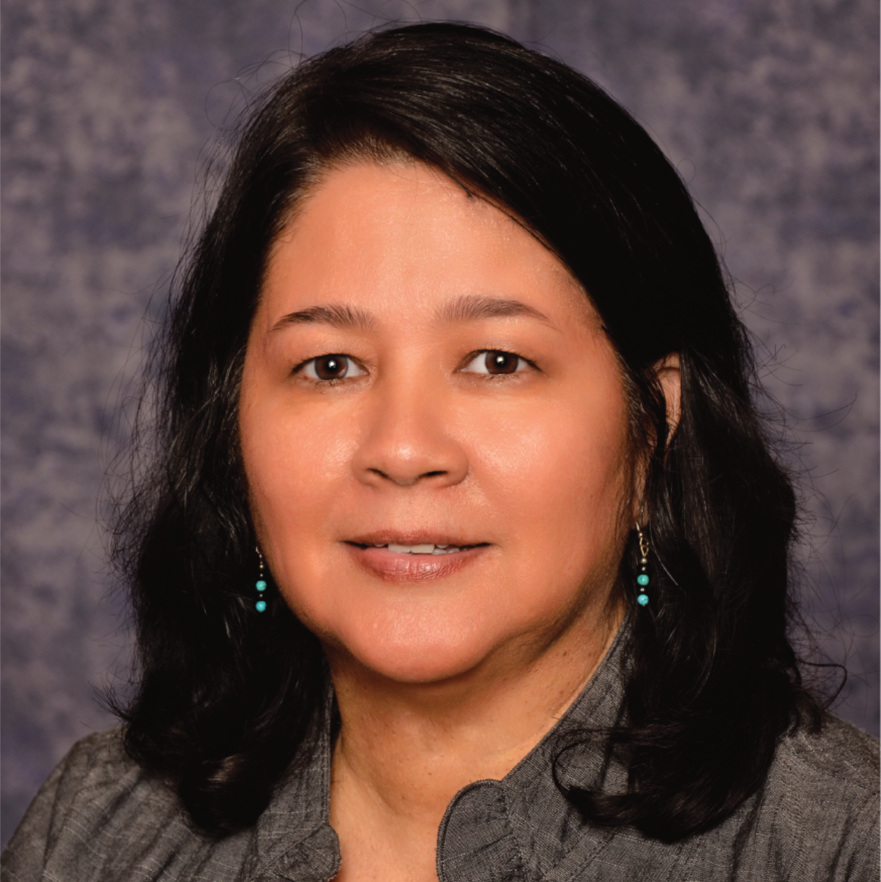
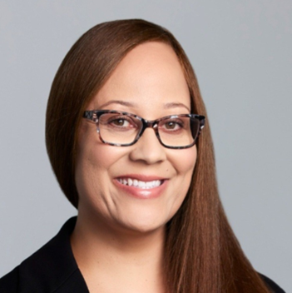
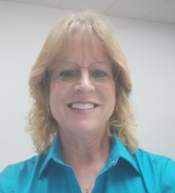
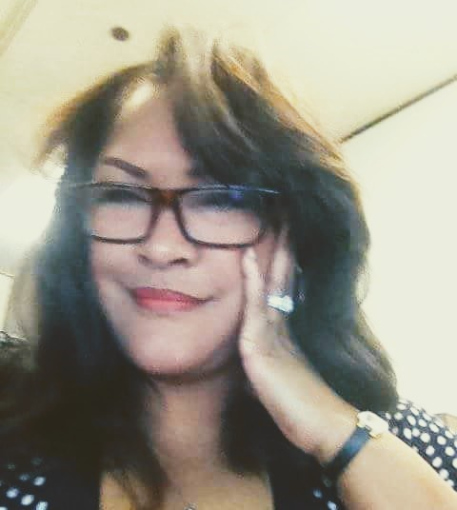
Meet the Services Committee
Expanding Access, Opportunity and Training
Keith King
Founder and CEO
Brigadier General (Ret) Richard Miller
President
John E. Taylor (“JT”)
Services Committee Chairman and Board of Directors
Annette Stevenson, US Army Veteran, CPSD, C.P.M.
Board of Directors
Tammi Hart
Advisory Board and Certification Committee
Joann “Jo” M. Cobb
Certification Analyst, Certification Committee
Toni Moses
Relationship Manager, Certification Committee

Slide 6
Tips for Today

Slide 7



Do Your Homework!
Understand the corporation’s culture and supplier expectations.
Resources to reference:
Business Codes of Conduct
Supplier Standards Documents
Learn about the corporation’s goals and focus.
Resources to reference:
Annual Reports
Environmental, Social, Governance (ESG) Reports
Leverage supplier diversity professionals to help identify opportunities, pain points and unmet needs in their organization.

Slide 8
Corporate Members
180+

Slide 9
Meet Our Speaker

Slide 18
Veteran to Veteran Business Opportunities
Connect With Your Fellow SD/VOBs!
Enter the following information in the chat:
Name
Business
Email
Location
Services/Products Offered
Services/Products Needed
Don’t Forget to Register Your Business With VOCS, NVBDC’s Veteran to Veteran Connection Program!

Slide 19
NVBDC Contacts
Services Committee:
John "JT" Taylor, jtaylor@nvbdc.org
Certification Team:
Jeff King, jking@nvbdc.org
Toni Moses, tmoses@nvbdc.org
Jo Cobb, jcobb@nvbdc.org
MVO Task Force:
Kathy Poynton, kpoynton@nvbdc.org
JROTC Program:
Sid Taylor, staylor@nvbdc.org
Press Releases:
Hannah Waldrep, hwaldrep@nvbdc.org

Slide 20
Thank You for Joining Us Today
Upcoming Webinars
  NVBDC Services JumpStart Webinars
    June 27 – Delta Airlines
      11:00 a.m. – 12:30 p.m. EDT
    September 26 – UScellular
      11:00 a.m. – 12:30 p.m. EDT
Save the Date!
  “Doing Business with the Federal Reserve & Private Industry”
    August 8, 2024
    Location: Federal Reserve Bank of Detroit
  National Veteran Matchmaking Conference
    October 29-30, 2024
    Location: Detroit, MI
Notes:
29-30th of October, Renaissance Marriot Nationals

Slide 21









NVBDC Corporate Members

Slide 22











NVBDC Corporate Members

Slide 23








NVBDC Corporate Members

Slide 24









NVBDC Corporate Members

Slide 25








NVBDC Corporate Members

Slide 26


THANK YOU!
Call: 888-CERTIFIED
Visit: NVBDC.ORG
Follow Us:

