Slide 1

2024 NVBDC JumpStart Webinar
How to Do Business with Dell Technologies

Slide 2

Veteran to Veteran Business Opportunities
Connect With Your Fellow SD/VOBs!
Enter the following information in the chat:
Name
Business
Email
Location
Services/Products Offered
Services/Products Needed
Don’t Forget to Register Your Business With VOCS, NVBDC’s Veteran to Veteran Connection Program!

Slide 3
Agenda
Opening Remarks
Tips for Today
Meet Our Speakers
Presentation
Q & A
Wrap-up

Slide 4
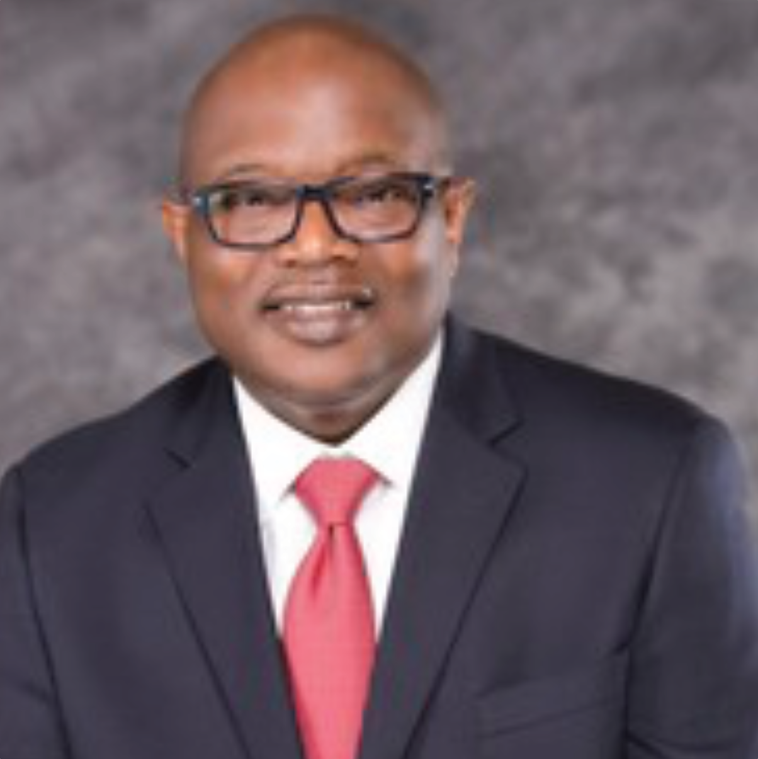
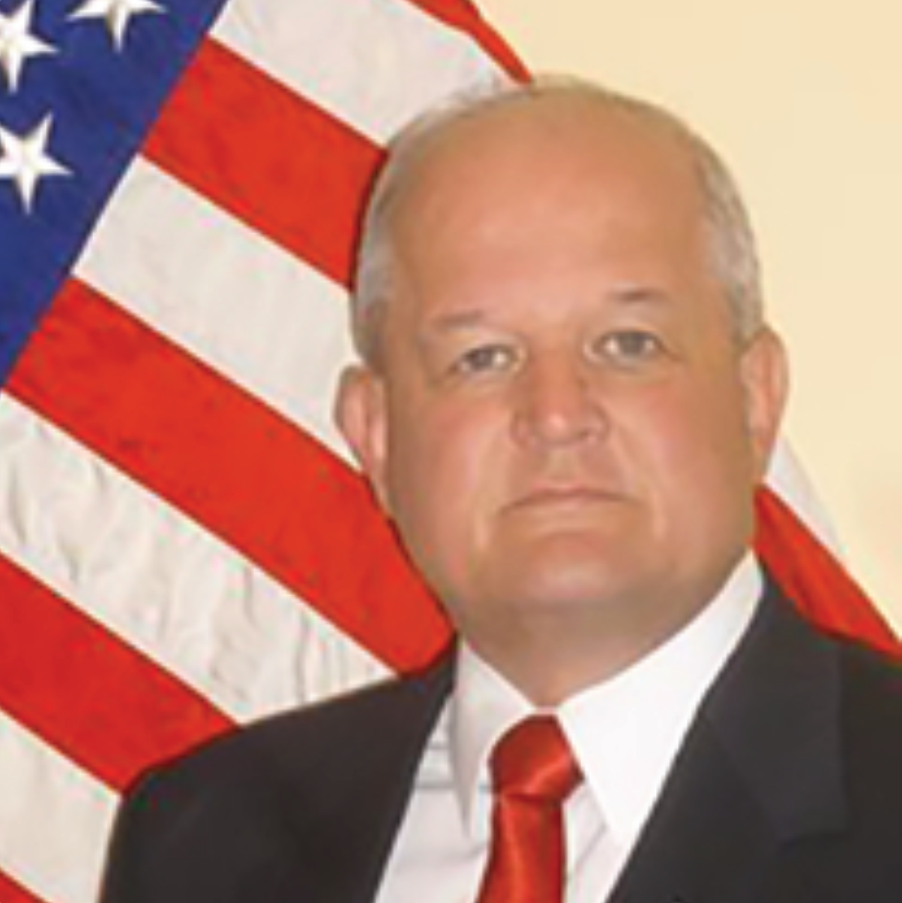
Opening Remarks
John E. Taylor (“JT”)
NVBDC Board Member
Chair, Services Committee
Brigadier General (ret) Richard Miller
President, NVBDC

Slide 5
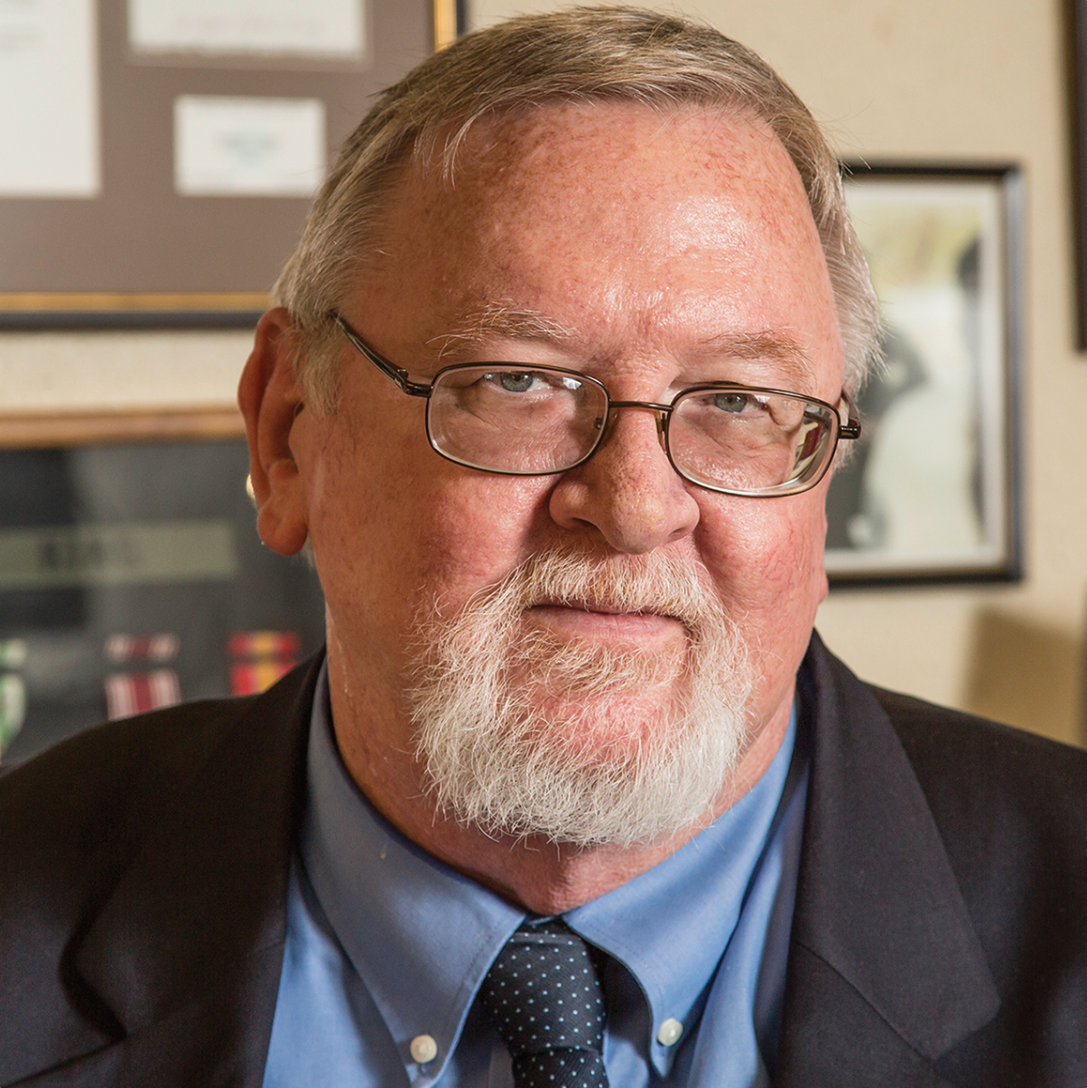
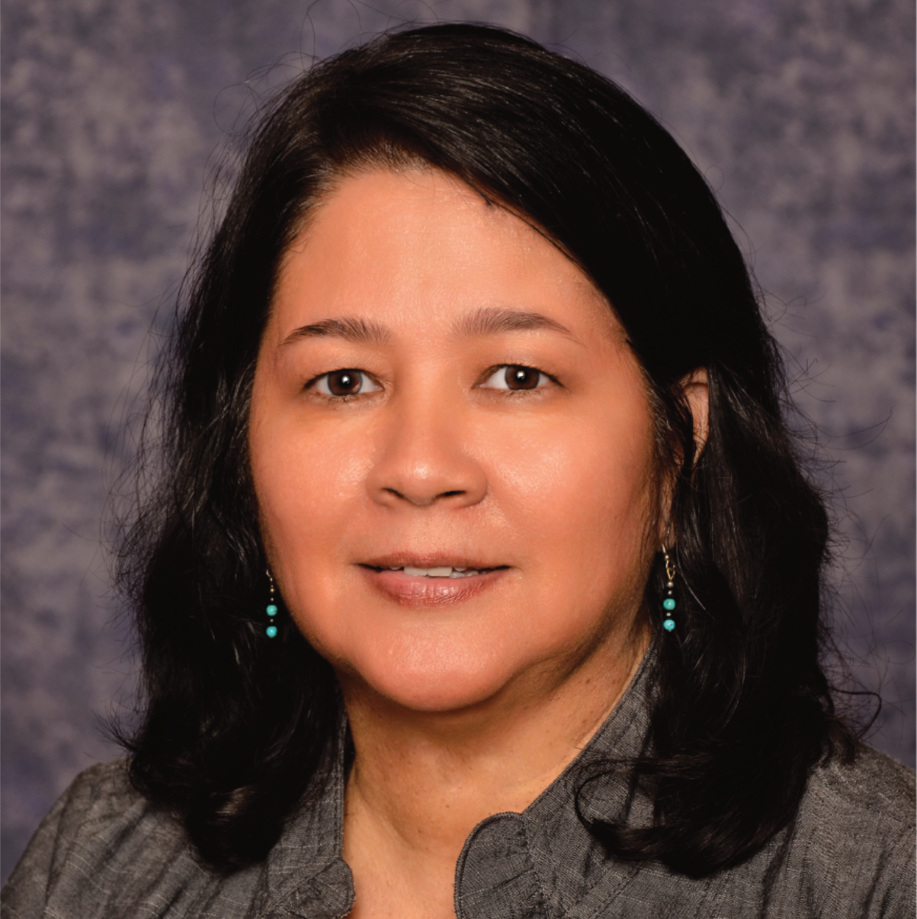
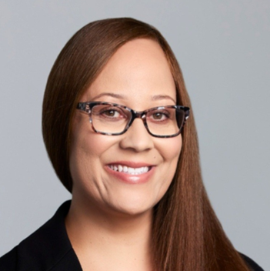
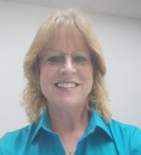
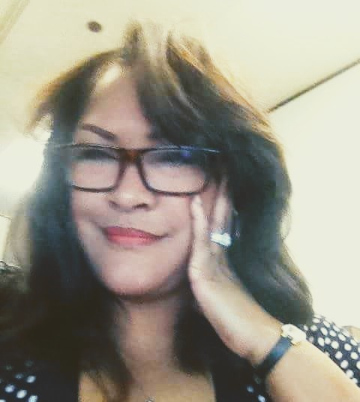
Meet the Services Committee
Expanding Access, Opportunity and Training
Keith King
Founder and CEO
Brigadier General (ret) Richard Miller
President
John E. Taylor (“JT”)
Services Committee Chairman and Board of Directors
Annette Stevenson, US Army Veteran, CPSD, C.P.M.
Board of Directors
Tammi Hart
Advisory Board and Certification Committee
Joann “Jo” M. Cobb
Certification Analyst, Certification Committee
Toni Mosess
Relationship Manager, Certification Committee

Slide 6
Tips for Today

Slide 7



Do Your Homework!
Understand the corporation’s culture and supplier expectations.
Resources to reference:
Business Codes of Conduct
Supplier Standards Documents
Learn about the corporation’s goals and focus.
Resources to reference:
Annual Reports
Environmental, Social, Governance (ESG) Reports
Leverage supplier diversity professionals to help identify opportunities, pain points and unmet needs in their organization.

Slide 8
Corporate Members
170+

Slide 9
Meet Our Speaker

Slide 10
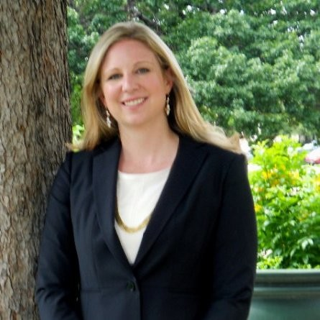
JumpStart Speaker
Meredith Melecki
Supplier Diversity Senior Manager
  Leads efforts to expand opportunities for small and diverse businesses
  Counsels senior leadership on initiatives for small and diverse suppliers
  Served as Chief of Staff to VP of Supply Chain Assurance
  Drove strategic initiatives for a responsible supply chain
  Analyzed risks in Texas Legislature
  Involved in international capability building programs
  BA in Political Science from University of Nebraska
  Graduate degrees in Journalism and International Relations from University of Wollongong, Australia

Slide 11
Doing Business With

Slide 31
Q&A

Slide 32
Veteran to Veteran Business Opportunities
Connect With Your Fellow SD/VOBs!
Enter the following information in the chat:
Name
Business
Email
Location
Services/Products Offered
Services/Products Needed
Don’t Forget to Register Your Business With VOCS, NVBDC’s Veteran to Veteran Connection Program!

Slide 33
NVBDC Contacts
Services Committee:
John "JT" Taylor, jtaylor@nvbdc.org
Certification Team:
Jeff King, jking@nvbdc.org
Toni Moses, tmoses@nvbdc.org
Jo Cobb, jcobb@nvbdc.org
MVO Task Force:
Kathy Poynton, kpoynton@nvbdc.org
JROTC Program:
Sid Taylor, staylor@nvbdc.org
Press Releases:
Hannah Waldrep, hwaldrep@nvbdc.org

Slide 34
Thank You for Joining Us Today
Upcoming Webinars
  NVBDC Services JumpStart Webinars
    May 23 – Flagstar Bank
      11:00 a.m. – 12:30 p.m. EDT
    June 27 – Delta Airlines
      11:00 a.m. – 12:30 p.m. EDT
Save the Date!
  “Doing Business with the Federal Reserve & Private Industry”
    August 8, 2024
    Location: Federal Reserve Bank of Detroit
  National Veteran Matchmaking Conference
    October 29-30, 2024
    Location: Detroit, MI
Notes:
29-30th of October, Renaissance Marriot Nationals

Slide 35

NVBDC Corporate Members

Slide 36

NVBDC Corporate Members

Slide 37

NVBDC Corporate Members

Slide 38

NVBDC Corporate Members

Slide 39


THANK YOU!
Call: 888-CERTIFIED
Visit: NVBDC.ORG
Follow Us:

