Slide 1

2024 NVBDC JumpStart Webinar
How to Do Business with Abbott Laboratories

Slide 2
Agenda
Opening Remarks
Tips for Today
Meet Our Speakers
Presentation
Q & A
Wrap-up

Slide 3
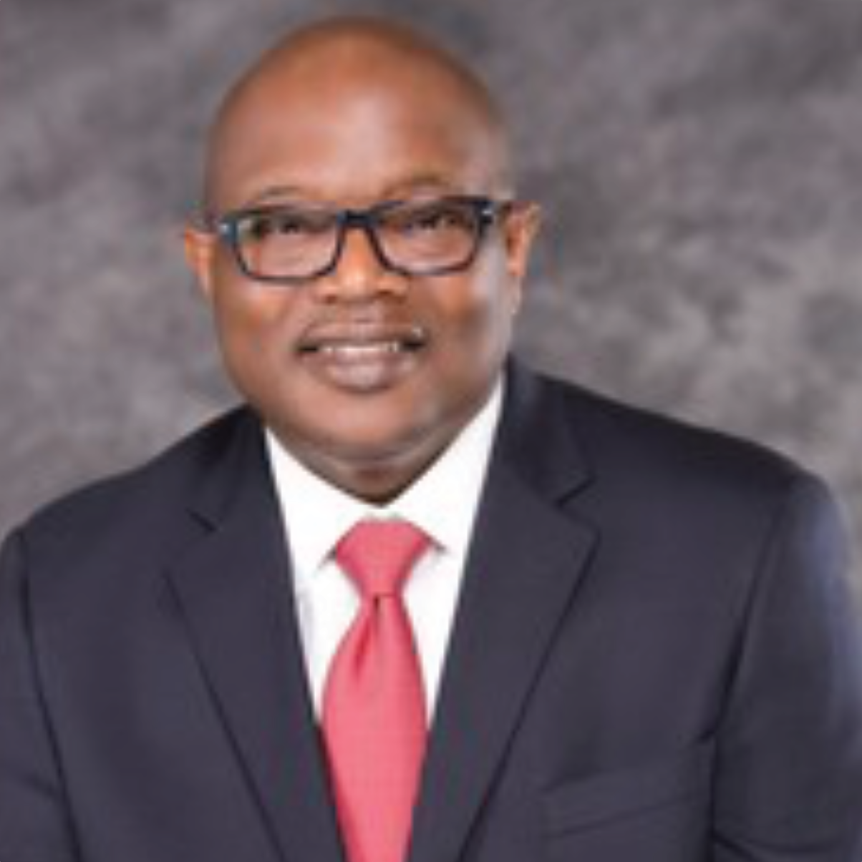
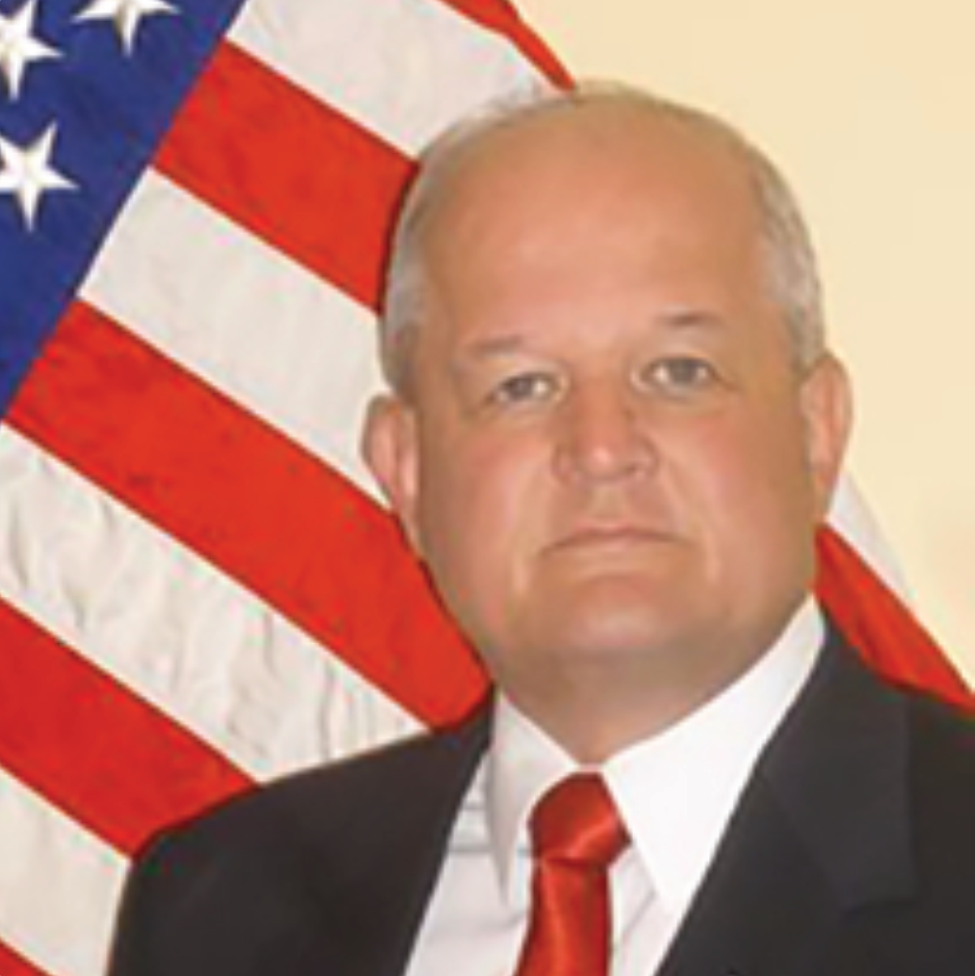
Opening Remarks
John E. Taylor (“JT”)
NVBDC Board Member
Chair, Services Committee
Brigadier General (ret) Richard Miller
President, NVBDC

Slide 4
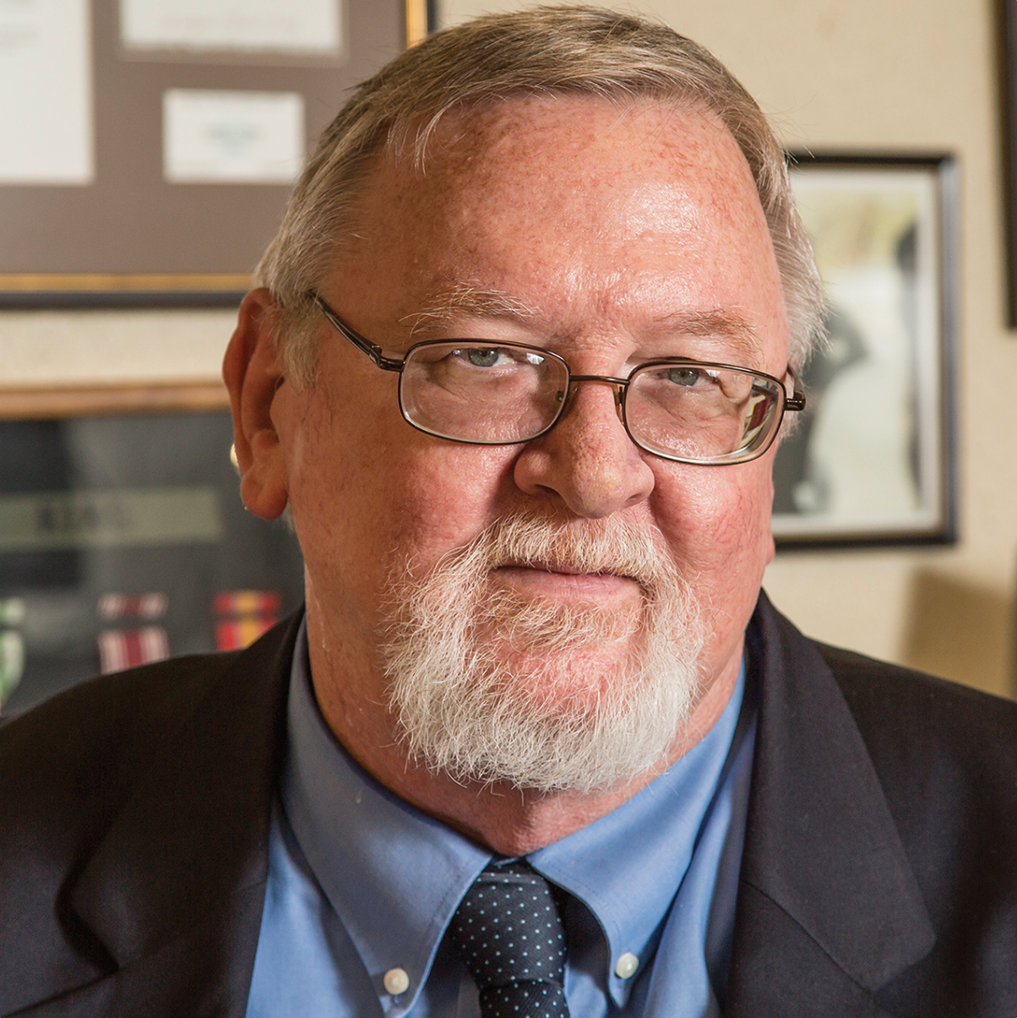
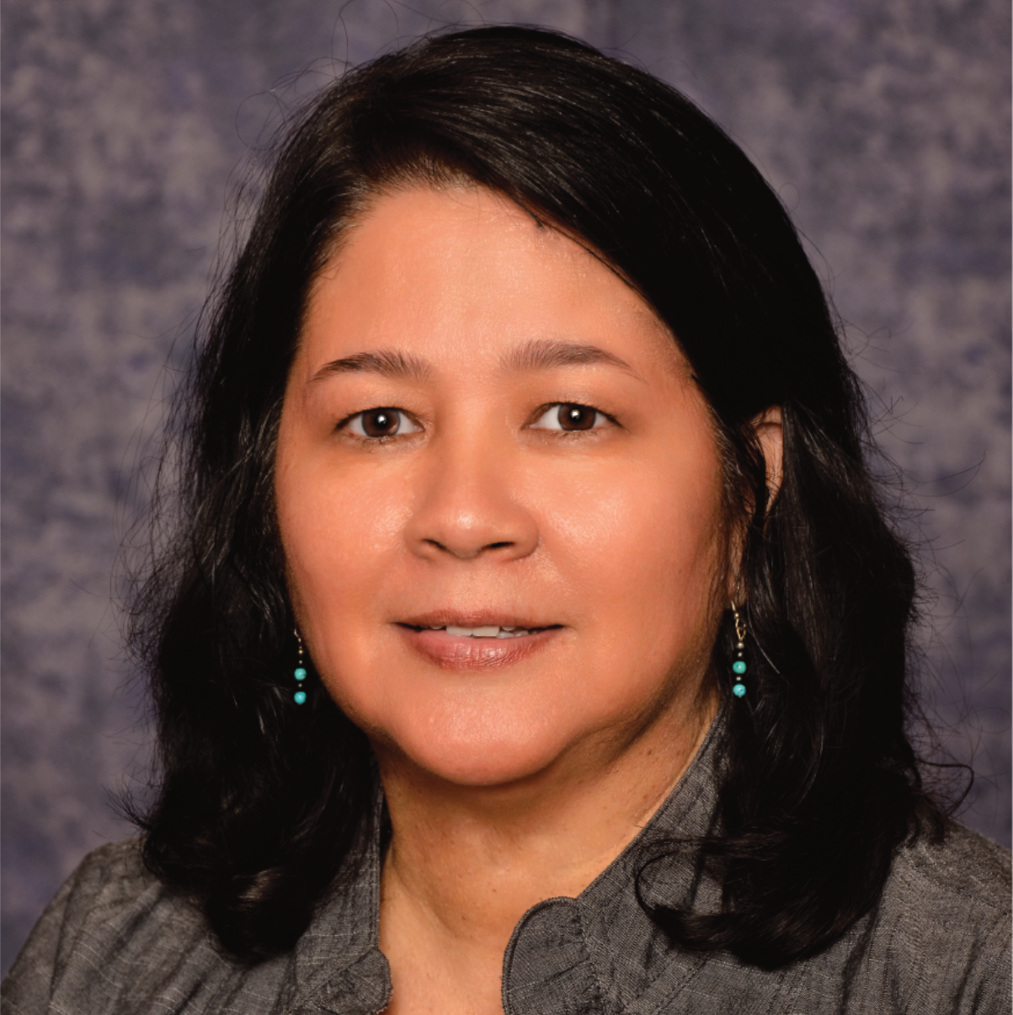
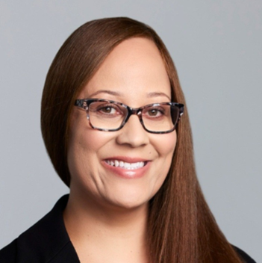
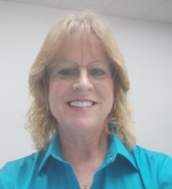
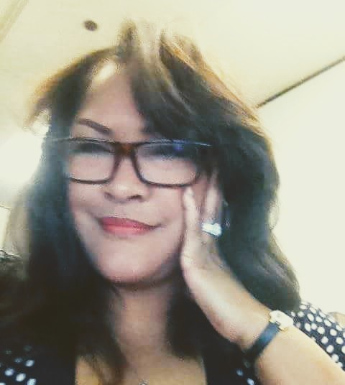
Meet the Services Committee
Expanding Access, Opportunity and Training
Keith King
Founder and CEO
Brigadier General (ret) Richard Miller
President
John E. Taylor (“JT”)
Services Committee Chairman and Board of Directors
Annette Stevenson, US Army Veteran, CPSD, C.P.M.
Board of Directors
Tammi Hart
Advisory Board and Certification Committee
Joann “Jo” M. Cobb
Certification Analyst, Certification Committee
Toni Mosess
Relationship Manager, Certification Committee

Slide 5
Tip for Today

Slide 6

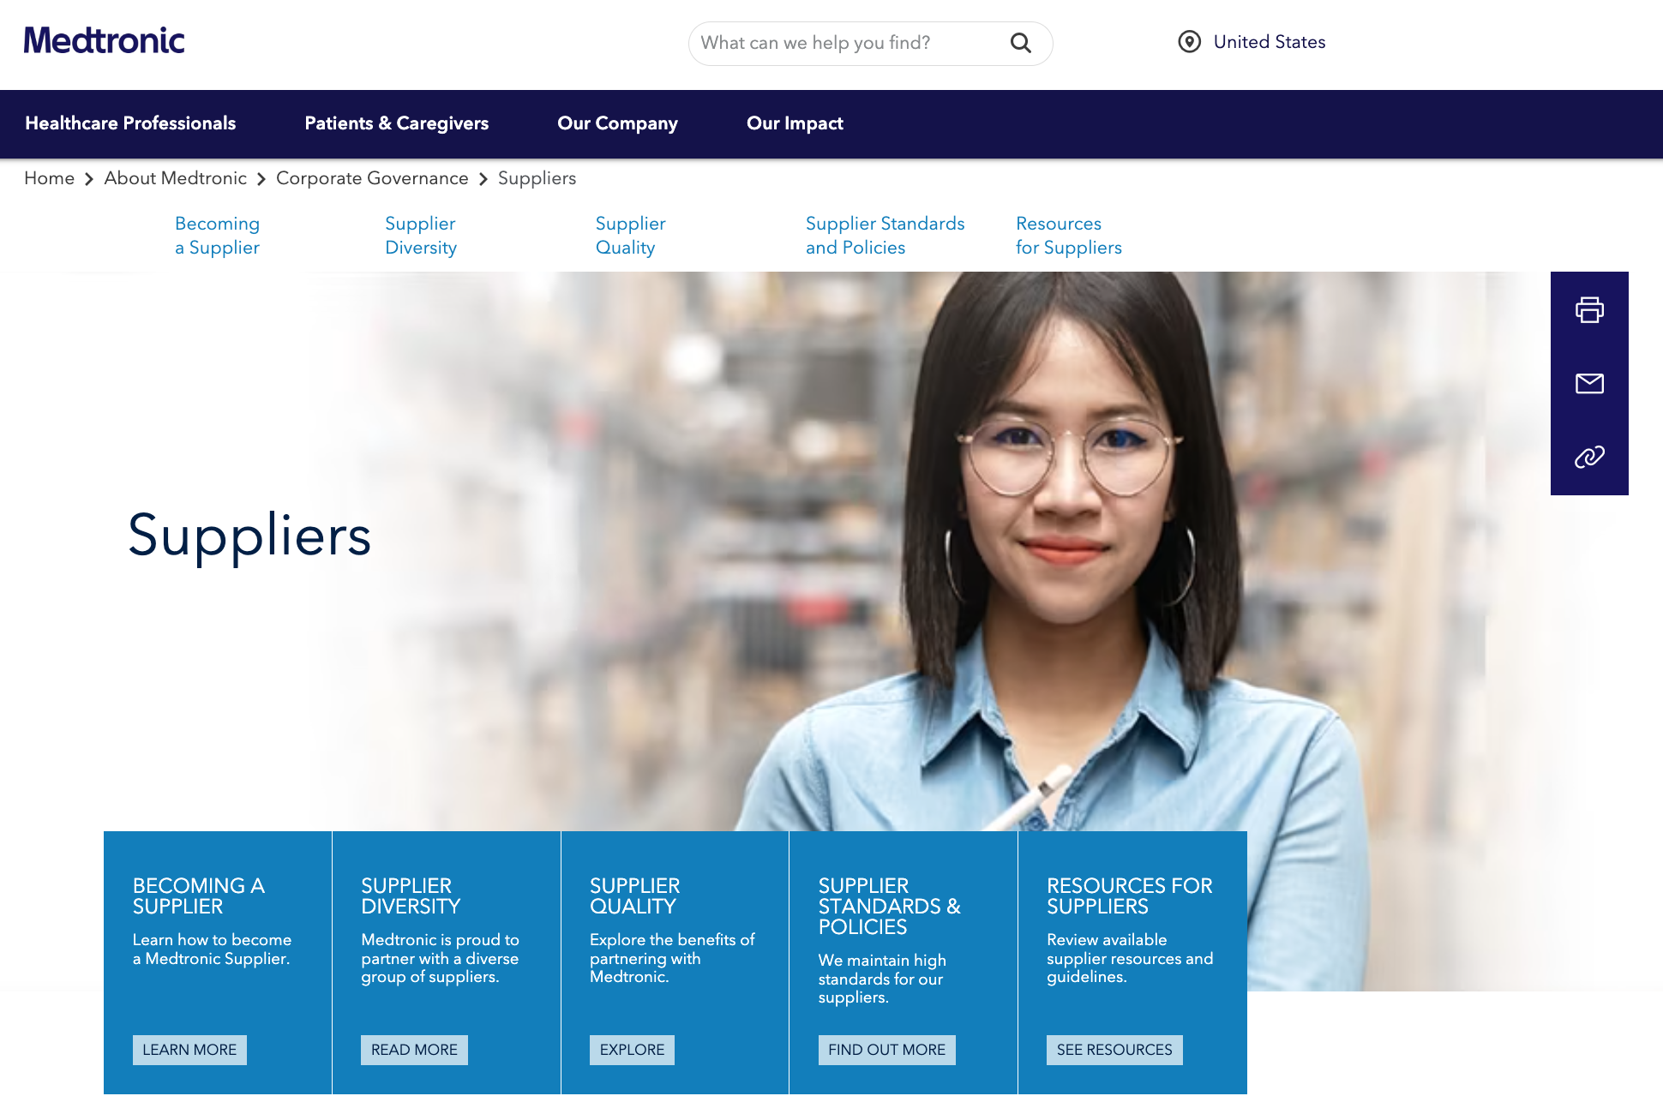

Do Your Homework!
Understand the corporation’s culture and supplier expectations.
Resources to reference:
Business Codes of Conduct
Supplier Standards Documents
FPO
FPO
Learn about the corporation’s goals and focus.
Resources to reference:
Annual Reports
Environmental, Social, Governance (ESG) Reports
FPO
Leverage supplier diversity professionals to help identify opportunities, pain points and unmet needs in their organization.

Slide 7
Corporate Members
180+

Slide 8
Meet Our Speaker

Slide 9
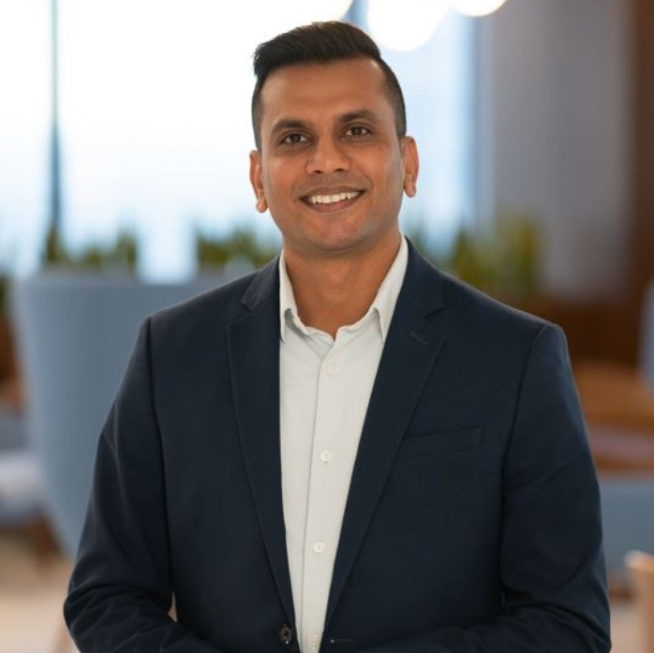
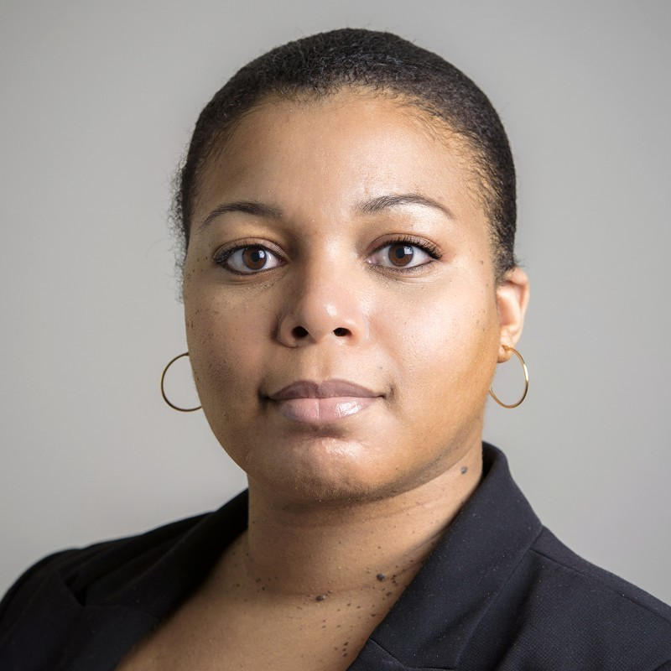
JumpStart Speakers
Bhavin Patel
Supplier Diversity Manager (Abbott)
Over 10 years of experience in supply chain operations, procurement, and supplier diversity in healthcare and technology industries
Drives economic inclusion and social impact for small and diverse suppliers through relationship management skills
Works with procurement professionals and business stakeholders to include small and diverse suppliers in addressing critical business needs
Akilah Hicks
Sr. Program Officer (LISC)
18 years of public sector experience, including 8 years in supply chain and diversity, equity & inclusion
Former Business Equity Manager at Port of Houston Authority
Subject-matter expert on small, minority, and woman-owned business enterprise programs
Served on committees, such as the mayoral appointment to Commissioner for the City of Houston’s Office of Business Opportunity
Passion for cultivating business culture and supporting MWBE business community nationwide

Slide 10
Doing Business With

Slide 32
Q&A

Slide 33
NVBDC Contacts
Services Committee:
John "JT" Taylor, jtaylor@nvbdc.org
Certification Team: Jeff King, jking@nvbdc.org Toni Moses, tmoses@nvbdc.org Jo Cobb, jcobb@nvbdc.org
MVO Task Force:
Kathy Poynton, kpoynton@nvbdc.org
JROTC Program:
Sid Taylor, staylor@nvbdc.org
Press Releases:
Hannah Waldrep, hwaldrep@nvbdc.org

Slide 34
Thank You for Joining Us Today
Upcoming Webinars
NVBDC Services JumpStart Webinars
April 25 – Dell Technologies
11:00 a.m. – 12:30 p.m. EDT
May 23 – Flagstar Bank
11:00 a.m. – 12:30 p.m. EDT
NVBDC Services Webinars
March 25 – Welcome Aboard Webinar

Slide 35
NVBDC Corporate Members

Slide 36
NVBDC Corporate Members

Slide 37
NVBDC Corporate Members

Slide 38
NVBDC Corporate Members

Slide 39


THANK YOU!
Call: 888-CERTIFIED
Visit: NVBDC.ORG
Follow Us:

