Slide 1
2024 NVBDC JumpStart Webinar
How to Do Business with Toyota North America

Slide 2

Opening Remarks
John E. Taylor (“JT”)
NVBDC Board Member
Chair, Services Committee

Slide 3
Agenda
Opening Remarks
Tips for Today
Meet Our Speakers
Presentation
Q & A
Wrap-up

Slide 4
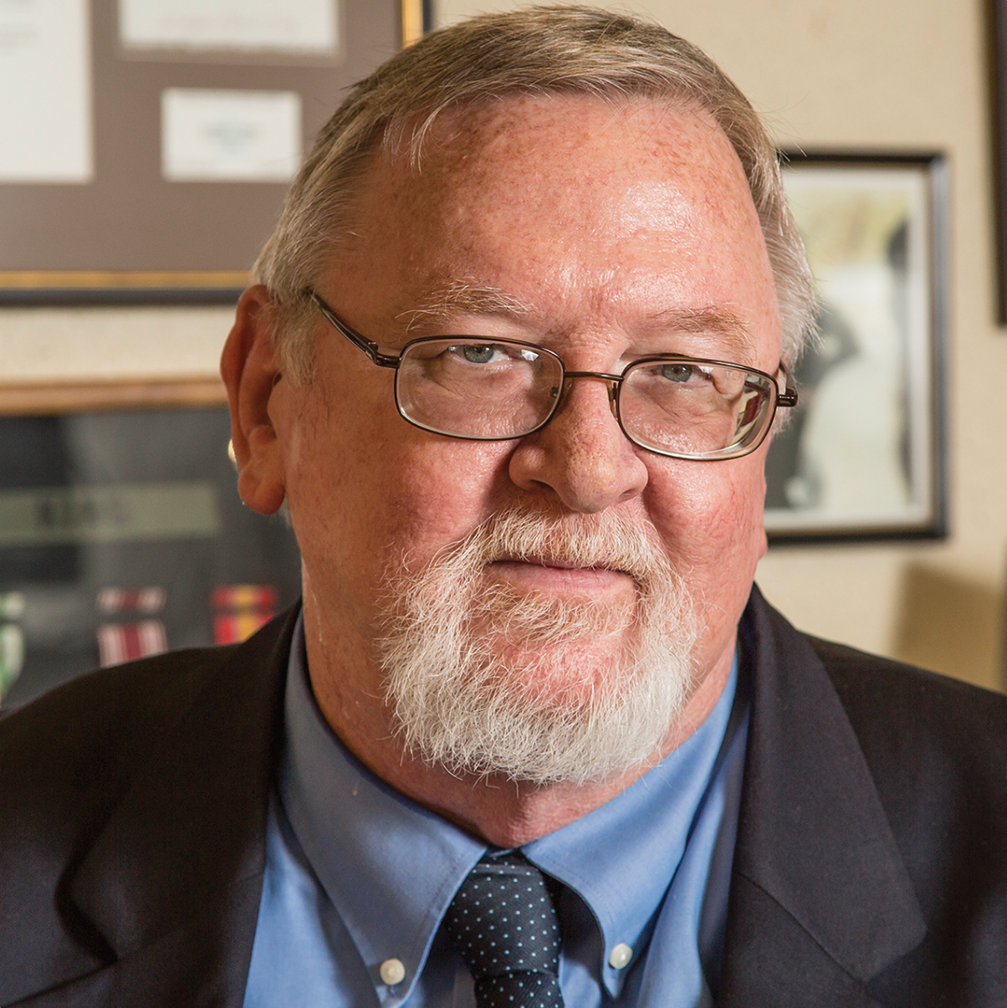
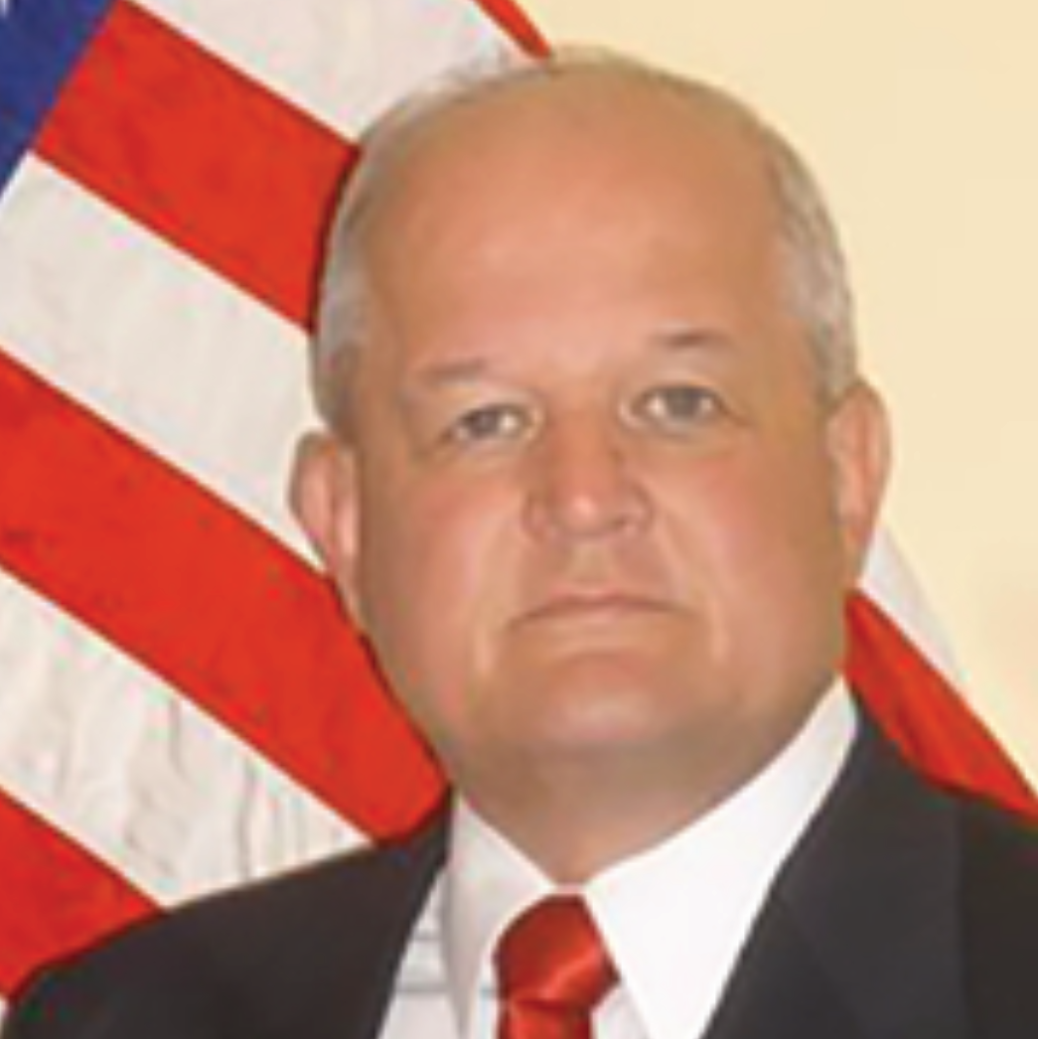
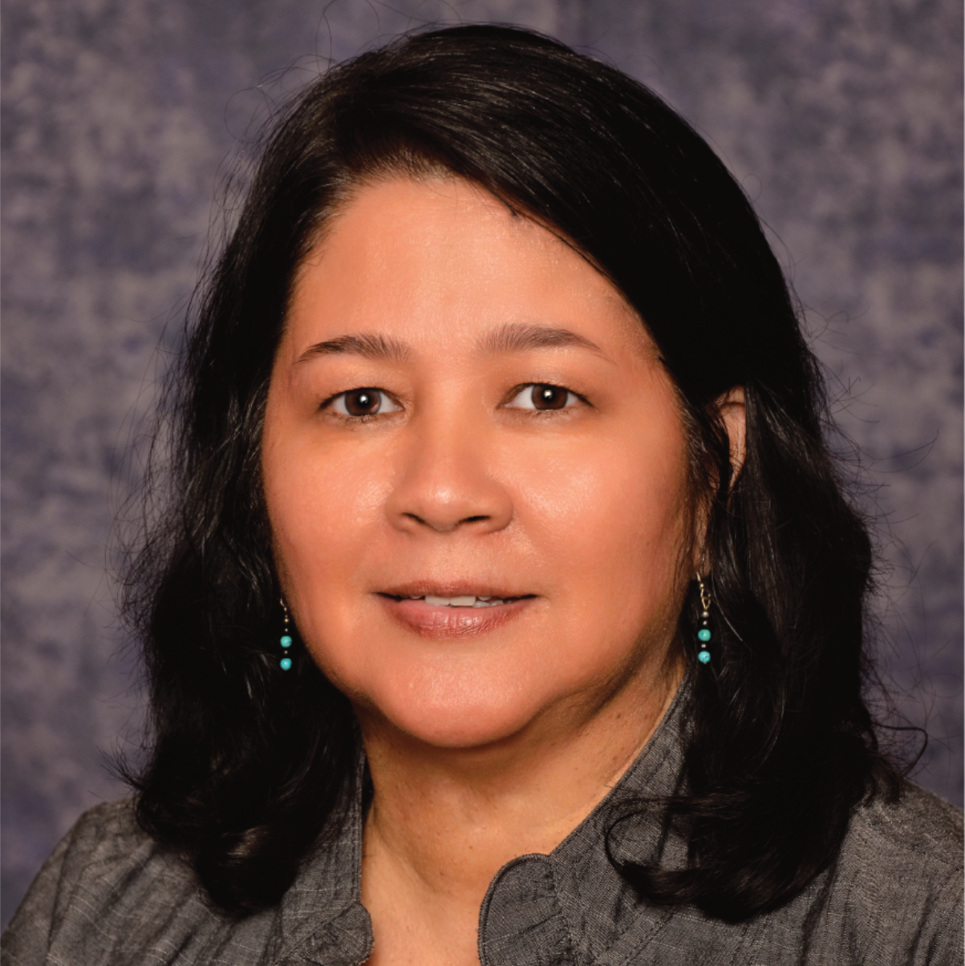
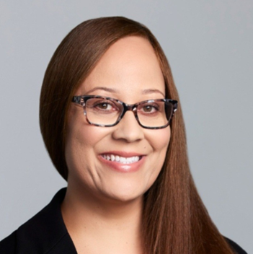
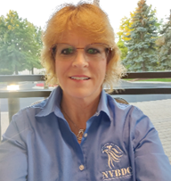

Meet the Services Committee
Expanding Access, Opportunity and Training
Keith King
Founder and CEO
Brigadier General (ret) Richard Miller
President
John E. Taylor (“JT”)
Services Committee Chairman and Board of Directors
Annette Stevenson, US Army Veteran, CPSD, C.P.M.
Board of Directors
Tammi Hart
Advisory Board and Certification Committee
Joann “Jo” M. Cobb
Certification Analyst, Certification Committee
Toni Mosess
Relationship Manager, Certification Committee

Slide 5
Tip for Today

Slide 6



Do Your Homework!
Understand the corporation’s culture and supplier expectations.
Resources to reference:
Business Codes of Conduct
Supplier Standards Documents
FPO
FPO
Learn about the corporation’s goals and focus.
Resources to reference:
Annual Reports
Environmental, Social, Governance (ESG) Reports
FPO
Leverage supplier diversity professionals to help identify opportunities, pain points and unmet needs in their organization.

Slide 7
Corporate Members
170+

Slide 8
Meet Our Speakers

Slide 9


Toyota Speakers
Jennifer Hoffman
Supplier Diversity Manager
Ryoko Watanabe
Supplier Diversity Analyst

Slide 10

Doing Business With

Slide 32
Q&A

Slide 33
NVBDC Contacts
Services Committee:
John "JT" Taylor, jtaylor@nvbdc.org
Certification Team: Jeff King, jking@nvbdc.org Toni Moses, tmoses@nvbdc.org Jo Cobb, jcobb@nvbdc.org
MVO Task Force:
Kathy Poynton, kpoynton@nvbdc.org
JROTC Program:
Sid Taylor, staylor@nvbdc.org
Press Releases:
Hannah Waldrep, hwaldrep@nvbdc.org

Slide 34
Thank You for Joining Us Today
Upcoming Webinars
NVBDC Services JumpStart Webinars
February 29 – Abbott
11:00 a.m. – 12:30 p.m. EDT
April 25 – Dell Technologies
11:00 a.m. – 12:30 p.m. EDT
NVBDC Services Webinars
March 25 – Welcome Aboard Webinar

Slide 35


Slide 36


Slide 37




Slide 39


THANK YOU!
Call: 888-CERTIFIED
Visit: NVBDC.ORG
Follow Us:

