Slide 1
2023 NVBDC Educational Webinar
Best Practices: Compelling Capability Statements and Event Networking

Slide 2
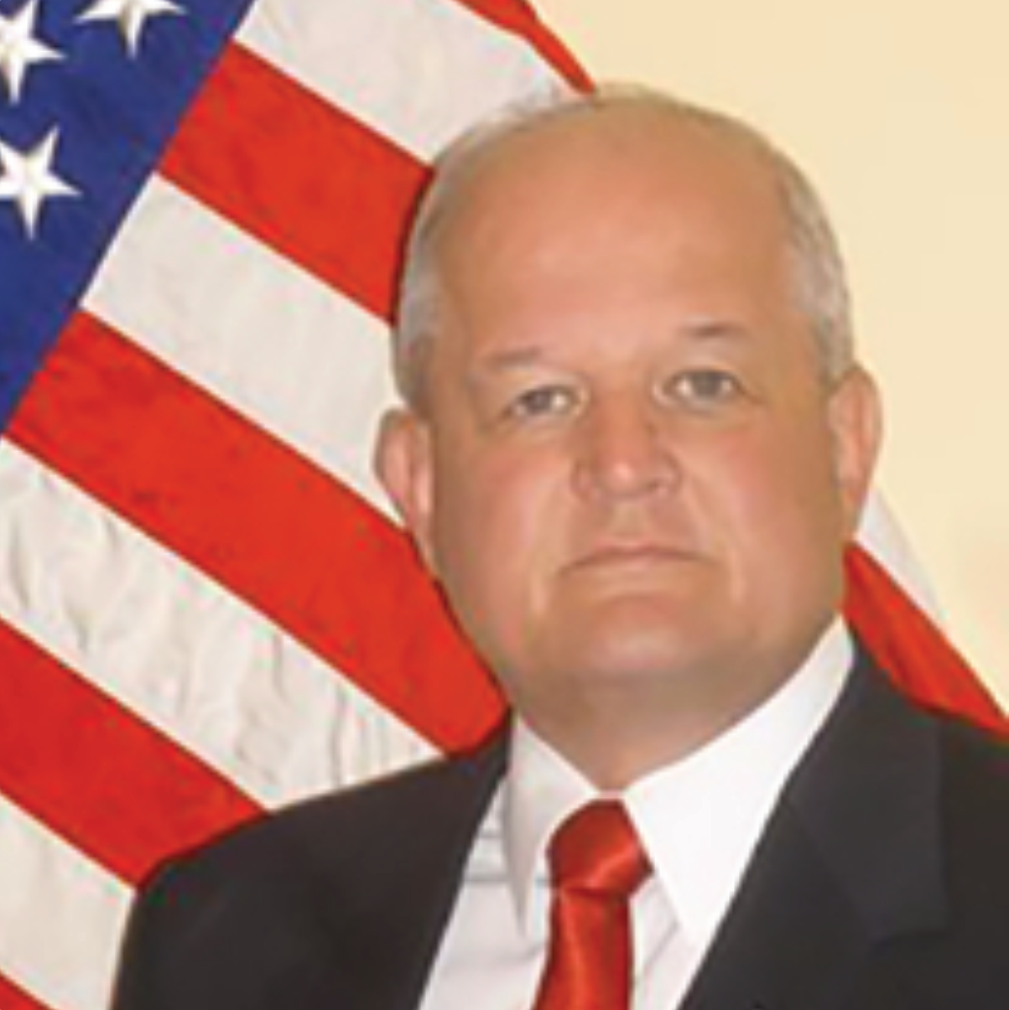
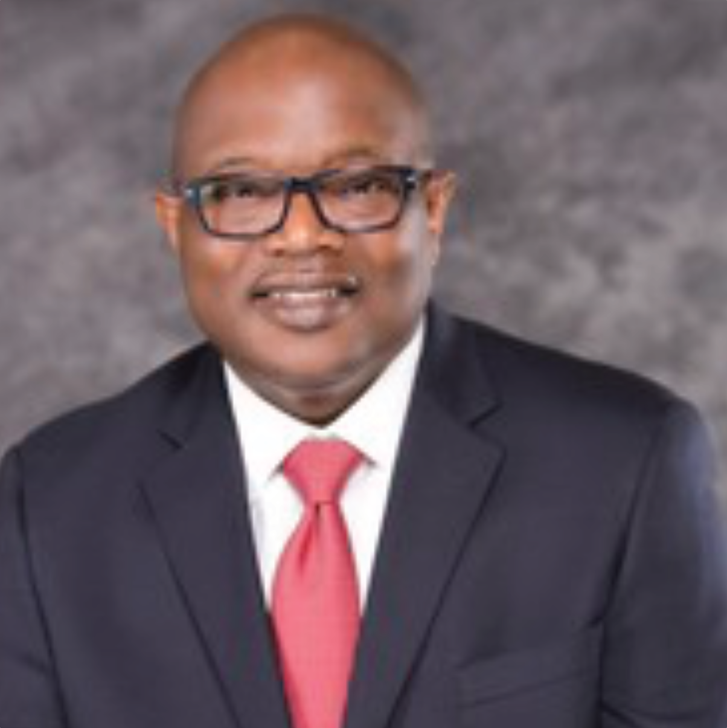
Opening Remarks
Brigadier General (ret) Richard Miller
President, NVBDC
John E. Taylor (“JT”)
NVBDC Board Member
Chair, Services Committee

Slide 3
Opening Remarks
Brigadier General (ret) Richard Miller
President, NVBDC

Slide 4
Agenda
Opening Remarks
Meet Our Speakers
Presentation
Q & A
Wrap-up

Slide 5
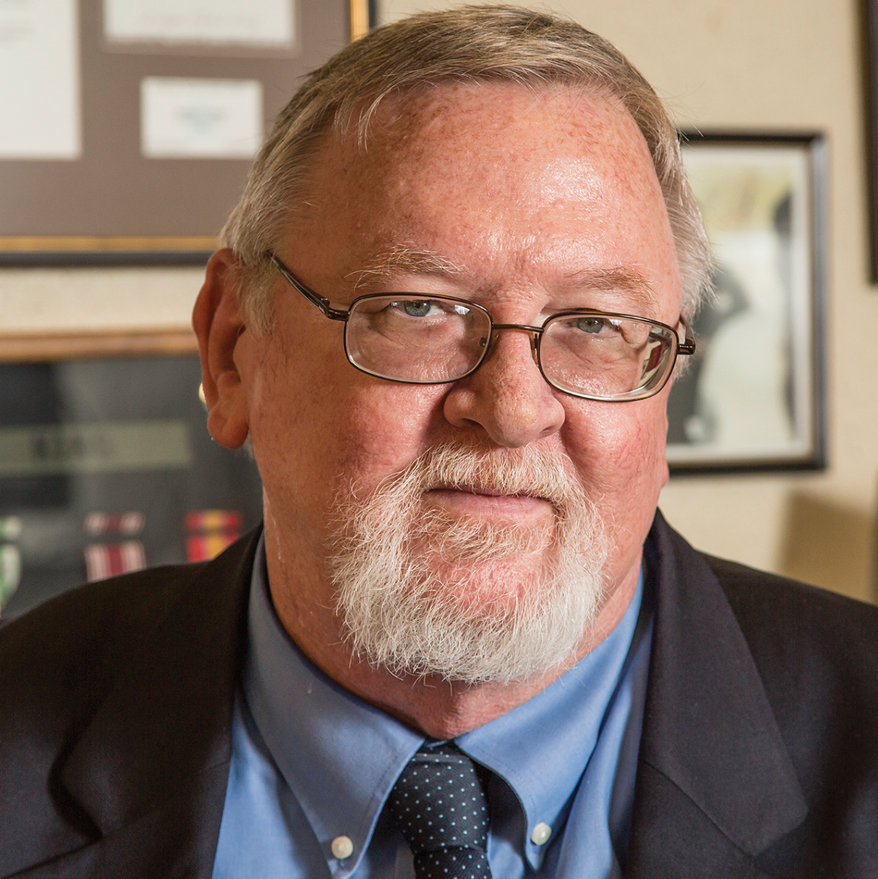
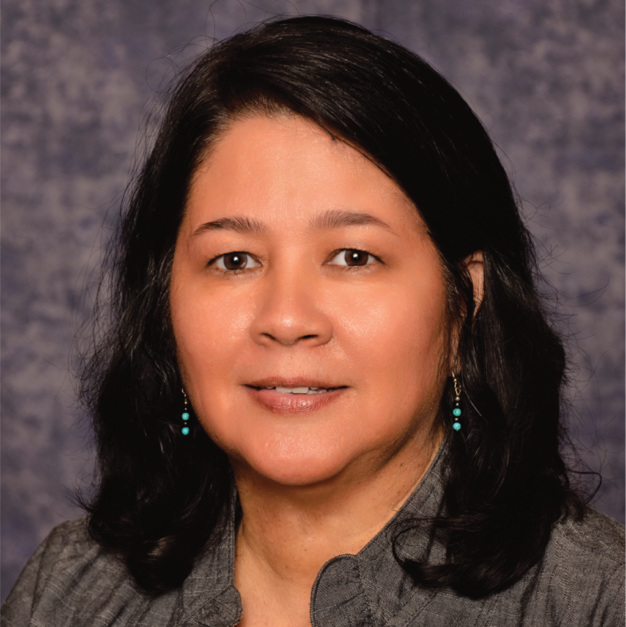
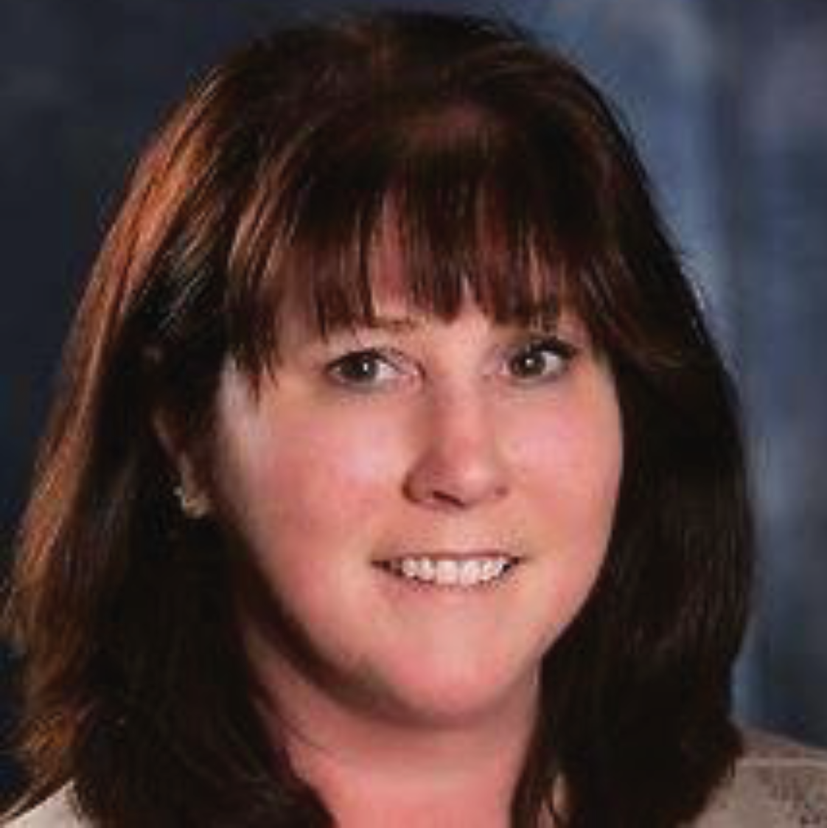
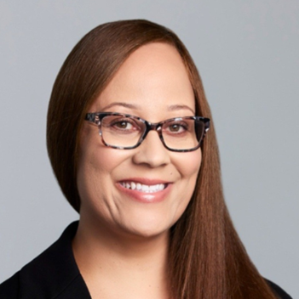
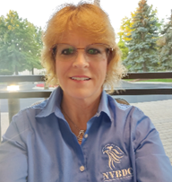

Meet the Services Committee
Expanding Access, Opportunity and Training
Keith King
Founder and CEO
Brigadier General (ret) Richard Miller
President
John E. Taylor (“JT”)
Services Committee Chairman and Board of Directors
Annette Stevenson, US Army Veteran, CPSD, C.P.M.
Board of Directors
Lieutenant Colonel (ret) Kathryn Poynton
MVO Task Force Director and Board of Directors
Tammi Hart
Advisory Board and Certification Committee
Joann “Jo” M. Cobb
Certification Analyst, Certification Committee

Slide 6
Meet Our Speakers

Slide 7
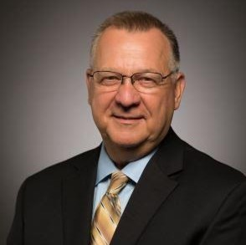
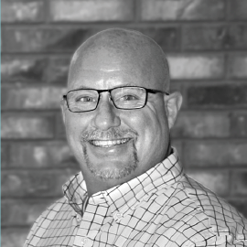
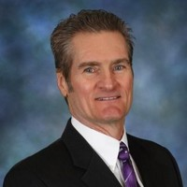
Speakers
Ken Erdelt, MBA
Business Coach & Advisor, AdviCoach
Veteran, USAF
Mark Hollingshead
President, DeltaPoint Partners LLC
Paul F. Mara
Diverse Business Resource Consultant, DSDC
Corporate & SD/VOB Outreach Consultant, NVBDC
Veteran, US Army

Slide 42
Q&A

Slide 43
NVBDC Contacts
Services Committee:
John "JT" Taylor, jtaylor@nvbdc.org
Certification Team: Jeff King, jking@nvbdc.org Toni Moses, tmoses@nvbdc.org Jo Cobb, jcobb@nvbdc.org
MVO Task Force:
Kathy Poynton, kpoynton@nvbdc.org
JROTC Program:
Sid Taylor, staylor@nvbdc.org
Press Releases:
Hannah Waldrep, hwaldrep@nvbdc.org

Slide 44
Thank You for Joining Us Today
Upcoming Webinars
NVBDC Services JumpStart Webinars
October 19 - Freddie Mac
1:00 p.m. - 2:30 p.m. EDT
December 7 – CVS
11:00 a.m. - 12:30 p.m. EDT
Live Events
NMSDC Annual Conference & Exchange
October 22-25, 2023
Location: Baltimore, MD
NVBDC National Event
November 8 - 9, 2023
Location: Louisville, KY

Slide 45


Slide 46


Slide 47




Slide 49


THANK YOU!
Call: 888-CERTIFIED
Visit: NVBDC.ORG
Follow Us:

